Slide 1


2D Barcode Implementation Journey
A Practical Guide for Retailers and Brand Owners
For the best user experience, begin in slide show mode and use the navigation buttons to explore the guide at your own pace and find the information you need quickly. Refer to slide 3 for additional instructions on using the guide's features.

Slide 2




Scope of this guide
Certain items are out of scope
Before using this document, consider that some certain subjects or items are not covered with the goal of lowering complexity and improving usability for the intended stakeholders. The following subjects or items have not been included in this document:
Regulated healthcare items
→ For more information on this 2D Barcode Implementation Journey, please refer to the GS1 data matrix for healthcare
Solution provider guidance
→ For more information on this 2D barcode implementation journey, please refer to the GS1 solution provider capability website
Industry or product type specific guidance
Barcode application for packaging not used at point-of-sale
→ For more information on this 2D barcode implementation journey, please refer to the GS1 general specifications
Check the appendix for a more detailed overview of in-scope and out-of-scope subjects.

Slide 3
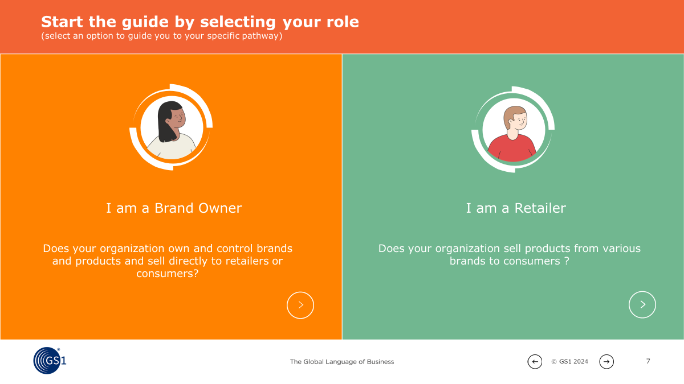
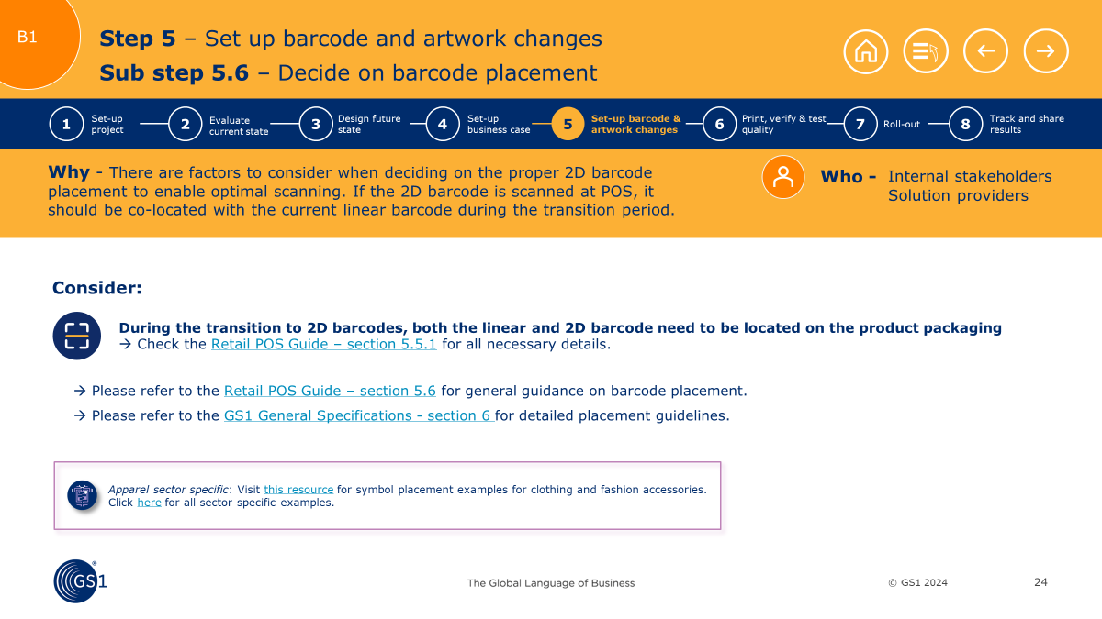
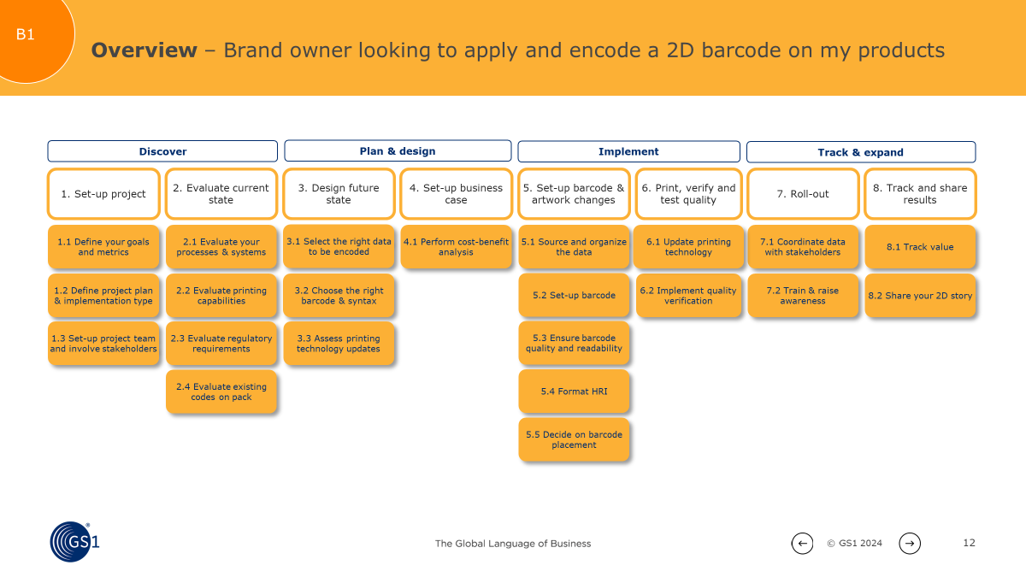
How to use this guide
About the guide
This guide serves as a practical roadmap for brand owners and retailers looking to implement 2D barcodes in their operations. It is designed to help you navigate the key business questions and considerations that are essential for a successful 2D barcode implementation.
How to navigate
1
Steps navigation
Return to the start of the guide
Back to steps overview
Previous/next step
Tell us about yourself
Start by defining your role and primary use case
3
Dive deeper
Each step includes key considerations, links to GS1 documentation and sector-specific watch-outs.
2
See the big picture
Get a comprehensive overview of the key implementation steps involved
Sector-specific examples
Clickable link to more detailed information
Contact your local GS1 office if you require support with navigating the document

Slide 4



2D Barcodes: A Quick Refresher
Unlocking new possibilities with 2D Barcodes powered by GS1
2D barcodes are becoming a key enabler in creating enhanced consumer experiences and unlocking advanced business use cases...all while still going “beep” at the checkout.
GS1 is supporting industry along this journey with its Global Migration to 2D initiative, which aims to ensure that 2D barcodes are readable at POS around the world by the end of 2027.
2D barcodes represent a significant advancement over traditional barcodes, storing considerably more data to enable the following use cases and more:
Learn more about 2D barcodes on the GS1 2D in Retail webpage.
Learn more about global 2D implementations
“When we embedded GS1 Digital Link in our QR Codes, something magical happened. We connected everything to everyone at any time”
Learn more about how Parla Deli is unlocking business value and connecting to customers with 2D.
“Woolworths can reduce food waste by up to 40% and improve productivity by up to 21% for articles that have fully transitioned to 2D barcodes”
Learn more about the multiple benefits Woolworths Australia is realising from 2D barcodes.
Consumer
Engagement
Sustainability
Improved
Packaging
“We are saving time, simplifying operations in stores, making our stock management processes more efficient”
Learn more about how 2D barcodes are providing consumers in Thailand a better experience at their local 7-Eleven.
Inventory
Management
Safety
Traceability

Slide 5



Start the guide by selecting your role
(Select an option to guide you to your specific pathway)
I am a Brand Owner
I am a Retailer
  Does your organisation own and control brands and products and sell directly to retailers or consumers?
  Does your organisation sell products from various brands to consumers ?

Slide 6


BRAND OWNERS
Click on the scenario to start your 2D barcode implementation journey:
Ambition 2027
By 2027, having 2D barcodes on all packages will be the industry standard. Start today to avoid falling behind, gain a competitive advantage and ensure smooth operations in the coming years. The next pages outline a clear roadmap for successful 2D barcode implementation. Whether your goal is boosting consumer engagement, optimising your supply chain or staying ahead of regulatory changes, acting now will unlock the full potential of this powerful technology.
Using the tool
In the steps that follow, this tool will assist you, as a brand owner, in understanding and planning the next stages of your 2D barcode implementation journey.
We will guide you in taking the appropriate steps, considering what factors to keep in mind and connecting you with the necessary information when you want to dive deeper.
I am a brand owner looking to apply and encode a 2D barcode on
my products

Slide 7

Overview – Brand owner or retailer looking to apply and encode a 2D barcode on my products
Discover
Plan & design
Implement
Track & expand
1. Set up project
2. Evaluate current state
3. Design future state
4. Set up business case
5. Set up barcode & artwork changes
6. Print, verify & test quality
7. Roll out
8. Track and share results
1.1 Define your goals
and metrics
2.1 Evaluate your processes and systems
3.1 Select the right data to be encoded
4.1 Perform cost-benefit analysis
5.1 Source and organise the data
6.1 Update printing technology
7.1 Coordinate external communication
8.1 Track value
1.2 Define project plan & implementation type
2.2 Evaluate printing capabilities
3.2 Choose the right barcode & syntax
5.2 Set up barcode
6.2 Verify & test
7.2 Train & raise awareness
8.2 Share your 2D story
1.3 Set up project team & involve stakeholders
2.3 Evaluate regulatory requirements
3.3 Assess printing technology updates
5.3 Set up access to digital content
2.4 Evaluate existing codes on pack
5.4 Ensure barcode quality & readability
5.5 Format HRI
5.6 Decide on barcode placement
= Step always needed
= Step only needed if use case requires encoding of dynamic data, which requires printing on production line and if that is not being done already today

Slide 8


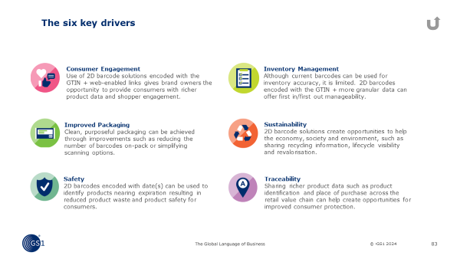



.
Step 1 – Set up project
Sub step 1.1 – Define your goals and metrics
1
Set-up project
2
Evaluate current state
3
Design future state
4
Set-up business case
5
Set-up barcode & artwork changes
6
Print, verify & test quality
7
Roll-out
8
Track and share results
Why - Being clear on your key driver(s), business goals and metrics is vital for a successful 2D implementation and to measure success once the implementation is complete.
Who -
Internal stakeholders
Retailers
Consider:
Choosing your key driver(s) or use case(s)
→ Check 2D Pilot Toolkit - slide 19-20 for all necessary information and
→ Check the appendix for an explanation on key drivers and key KPIs and goals.
Evaluating your estimated budget through a cost logic
→ Check the 2D Pilot Toolkit section - slide 30-33 for all necessary details.
How 2D implementation could benefit the consumer experience
→ Check 2D Pilot Toolkit - slide 21 for all necessary information.
Important: align the interests of both your internal stakeholders and retailers with these goals and metrics.
→ Please refer to Retail POS Guide – section 4 or visit our case study library for more example use cases.
Click here for a full explanation per key driver
!

Slide 9



.
Step 1 – Set up project
Sub step 1.2 – Define project plan & implementation type
1
Set-up project
2
Evaluate current state
3
Design future state
4
Set-up business case
5
Set-up barcode & artwork changes
6
Print, verify & test quality
7
Roll-out
8
Track and share results
Why - The 2D roll-out process is important to execute well. It is key to start with the right scope and Set up and use the results to decide on further deployment.
Who -
Internal stakeholders
Consider:
Creating a project plan
Choosing an implementation type (e.g. proof of concept, pilot, full implementation)
Start your implementation with a (number of) product(s)
Please refer to 2D Pilot Toolkit - slide 35-45 section for more information about scoping.

Slide 10



.
Step 1 – Set up project
Sub step 1.3 – Set up project team & involve stakeholders
1
Set-up project
2
Evaluate current state
3
Design future state
4
Set-up business case
5
Set-up barcode & artwork changes
6
Print, verify & test quality
7
Roll-out
8
Track and share results
Why - Based on your business objectives, determine which internal and external stakeholders to involve.
Who -
Internal stakeholders
Solution providers
Retailers
Consider:
Creating a core project team
Involving internal stakeholders
→ Check the Retail POS Guide – section 5.1 for all necessary details.
Involving external stakeholders
→ Please refer to the 2D Pilot Toolkit - slide 47-49 for more information about identifying the right stakeholders.

Slide 11



.
Step 2 – Evaluate current state
Sub step 2.1 – Evaluate your processes and systems
1
Set-up project
2
Evaluate current state
3
Design future state
4
Set-up business case
5
Set-up barcode & artwork changes
6
Print, verify & test quality
7
Roll-out
8
Track and share results
Why - Evaluating current processes and systems is essential to be able to effectively bridge the gap between the current and the future state.
Who -
Internal stakeholders
Solution providers
Consider:
Thinking about the end-to-end impact to the whole value chain
Evaluating possible as-is processes that could be impacted
Evaluating possible data, web and IT systems that could be impacted
→ Please refer to the 2D Pilot Toolkit - slide 42-46 for more information about affected processes during 2D implementation.

Slide 12


.
Step 2 – Evaluate current state
Sub step 2.2 – Evaluate printing capabilities
1
Set-up project
2
Evaluate current state
3
Design future state
4
Set-up business case
5
Set-up barcode & artwork changes
6
Print, verify & test quality
7
Roll-out
8
Track and share results
Why - Assessing current printing capabilities is important as input to decide whether any upgrades are necessary.
Who -
Internal stakeholders
Solution providers
Consider:
Assessing the current barcode printing method(s)
Assessing the current capability to print different barcode symbologies (QR code, Data Matrix, GS1 DataMatrix)
Important: Collaborate with your solution provider to perform an accurate evaluation of your current printing capabilities and, if a change is required, identify available options in the market.
→ Refer to Retail POS Guide – section 8 to access a list of common printers and requirements for each, which could be useful as a basis for assessing your existing printing capabilities.
!

Slide 13

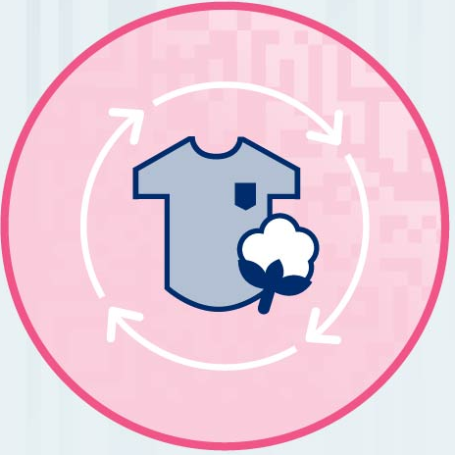
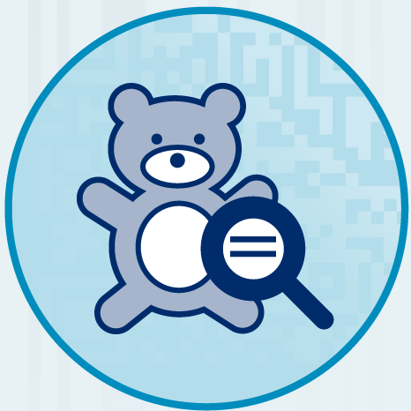
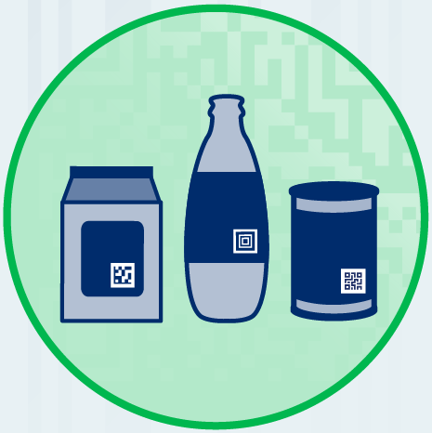
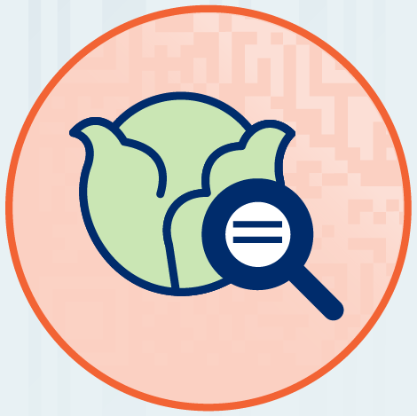
.
Step 2 – Evaluate current state
Sub step 2.3 – Evaluate regulatory requirements
1
Set-up project
2
Evaluate current state
3
Design future state
4
Set-up business case
5
Set-up barcode & artwork changes
6
Print, verify & test quality
7
Roll-out
8
Track and share results
Why - Ensuring compliance with industry-specific regulations and guidelines is critical for your business. Unlocking access to increased product information via 2D can help.
Who -
Internal stakeholders
Consider:
Taking into consideration specific regulations based on industry, product category or target market
Circularity
The global shift towards a circular economy is gaining momentum in the fight against climate change, particularly evident in the European Union’s legislative efforts to introduce a Digital Product Passport (DPP).
Product safety
Today, it is crucial to enable the instant sharing of reliable product information among all participants in the supply chain, while also ensuring that consumers have easy access to safety-related data about products.
Food safety
Regulators are asking food companies to share more details about safety, quality, where food comes from, and how it is grown. 2D barcodes bring nutritional and safety-related information to the hands of the consumer.
Packaging
Sustainable packaging is recognised as a key factor in advancing toward a more sustainable business model. Empowering consumers with the right information encourages environmentally conscious choices, contributing to a more sustainable future.
Important: Consider: all relevant regulations for your industry, as it might impact the ability to list in certain markets.
!

Slide 14



.
Step 2 – Evaluate current state
Sub step 2.4 – Evaluate existing codes on pack
1
Set-up project
2
Evaluate current state
3
Design future state
4
Set-up business case
5
Set-up barcode & artwork changes
6
Print, verify & test quality
7
Roll-out
8
Track and share results
Why - It is helpful to evaluate the existing codes on pack since some brand owners might already have 2D barcodes on their packaging for consumer engagement or other purposes. This will impact whether your printing capability requires an upgrade or not.
Who -
Internal stakeholders
Solution providers
Consider:
Upgrading existing, non-standardised 2D barcodes (for consumer engagement) to also be scannable at point-of-sale
Ensuring dual marking (of both 1D and 2D barcodes) to ensure scanability before global readiness
Evaluating data that is currently encoded in the 2D barcode
→ Please refer to the Retail POS Guide – section 5.3.7 for more information about transitioning to 2D barcodes.
!
Important: For products carrying RFID tags (such as Apparel), consider if the additional 2D barcode should go on the permanent mediums (typically part of the product), or time-limited use mediums (like a hang-tag or sticker).

Slide 15



.
Step 3 – Design future state
Sub step 3.1 – Select the right data to be encoded
1
Set-up project
2
Evaluate current state
3
Design future state
4
Set-up business case
5
Set-up barcode & artwork changes
6
Print, verify & test quality
7
Roll-out
8
Track and share results
Why - Define the essential information that needs to be encoded in the 2D barcode based on your business objectives.
Who -
Internal stakeholders
Solution providers
What is your key driver¹?
Consider:
Only consumer engagement and/or improved packaging
Also/only Traceability/Safety/Inventory management/Sustainability
Starting by using the GTIN and optionally Consumer Product Variant (CPV) data to unlock the use case value
Please refer to 2D Pilot Toolkit - Slide 41 for more information.
Choosing right data attributes (e.g., GTIN, batch #, …)
→ Check 2D Pilot Toolkit - slide 41 for all necessary information.
Browsing the list of Application Identifiers
→ Check the Retail POS Guide – section 4.4.2 and section 5.4.1 or GS1 general specifications – section 3 for all necessary information.
Consider: the minimal amount of data needed
Please refer to the Retail POS Guide – section 5.3 for use case examples with the correct data attributes.
Your local GS1 office can help with data selection.
Key drivers traceability, sustainability, safety and inventory management require encoding of dynamic data and require different considerations In case consumer engagement/improved packaging are the only key drivers, there are less considerations.

Slide 16




.
Step 3 – Design future state
Sub step 3.2 – Choose the right barcode and syntax
1
Set-up project
2
Evaluate current state
3
Design future state
4
Set-up business case
5
Set-up barcode & artwork changes
6
Print, verify & test quality
7
Roll-out
8
Track and share results
Why - Explore the different 2D barcodes to determine which one fits best with your selected business objectives. The choice of the barcode determines the right syntax.
Who -
Internal stakeholders
Solution providers
Consider:
Choosing one of three possible 2D barcode types, which determines the right syntax
Please refer to the 2D Barcodes Factsheet, Barcode Explorer and Retail POS Guide– section 4.5 for more information on barcode types.
→ Please refer to the GS1 General Specifications - sections 5.6-5.10 for more information about 2D features and symbology.
QR Code
Data Matrix
GS1 DataMatrix
Only 2D barcode that can be scanned by consumers with all smartphone cameras.
Connects to the web.
Can connect to the web but requires an app to scan with a smartphone.
Can be printed a little smaller than a QR Code.
Useful in supply chain applications where consumer engagement is not a requirement.
Requires an app to scan with a smartphone
GS1 Digital Link syntax
GS1 element string syntax

Slide 17

.
Step 3 – Design future state
Sub step 3.3 – Assess printing technology updates
1
Set-up project
2
Evaluate current state
3
Design future state
4
Set-up business case
5
Set-up barcode & artwork changes
6
Print, verify & test quality
7
Roll-out
8
Track and share results
Why - Assess whether changes need to be made to your current barcode printing technology to meet the future use case. Take into account the data and syntax that needs to be encoded (steps 3.1-3.2) and any existing 2D barcodes on your packaging (step 2.4).
Who -
Internal stakeholders
Solution providers
Consider::
Consider: also (if you require dynamic data):
Using a traditional pre-printing technique if the current processes allow for the data you require (e.g. only GTIN)
Using a digital production line printing technique
All factors that determine the printing method
→ Please refer to Retail POS Guide – section 7.4 for more information on printing types and factors to consider
Choosing a barcode creation software
→ Check the Retail POS Guide – section 7.3 for all necessary information.
→ Please refer to the Retail POS Guide – section 8 for more technical details on printing methods.
Important: If necessary, contact your solution provider to determine what equipment currently exists and what upgrades are required.
!

Slide 18



.
Step 4 – Set up business case
Sub step 4.1 – Perform cost-benefit analysis
1
Set-up project
2
Evaluate current state
3
Design future state
4
Set-up business case
5
Set-up barcode & artwork changes
6
Print, verify & test quality
7
Roll-out
8
Track and share results
Why - Based on the evaluations/assessments done in previous steps, determine whether you should continue your 2D implementation journey by creating a business case.
Who -
Internal stakeholders
Solution providers
Retailers
Consider:
Estimating the total costs involved
Calculating potential cost savings based on the chosen use case
Determining potential increases in sales or other key metrics defined
Important:
Engage with key internal stakeholders and collaborate with solution providers and retailers. Also consider costs or lost sales related to compliance e.g. non-compliance could impact the ability to list products in certain markets
For brands already using RFID, printing an additional 2D barcode for consumer engagement is potentially more cost-effective at scale as compared to investing in dual frequency UHF/NFC tags, without impacting read-rate or consumer accessibility.
Please refer to the 2D Pilot Toolkit - slides 24-33 for all details about cost and benefit logic.
Please refer to the appendix for a complete overview of key KPIs and business goals of the value drivers.
!

Slide 19



.
Step 5 – Set up barcode and artwork changes
Sub step 5.1 – Source and organise the data
1
Set-up project
2
Evaluate current state
3
Design future state
4
Set-up business case
5
Set-up barcode & artwork changes
6
Print, verify & test quality
7
Roll-out
8
Track and share results
Why - Making sure the required data for encoding is available, accurate, complete and up-to-date is essential to successfully implement 2D objectives.
Who -
Internal stakeholders
Solution providers
What is your key driver¹?
Consider:
Only consumer engagement/Improved packaging
Also/only Traceability/Safety/Inventory management/Sustainability
Since only the GTIN and optionally the CPV is encoded, this is no need to source and organise additional data
Verifying that all relevant data is available and collecting this from the identified sources
Implementing validation processes to ensure the data is accurate, complete and up-to-date
Developing and enforcing data governance policies to maintain data integrity and compliance
Key drivers traceability, sustainability, safety and inventory management require encoding of dynamic data and require different considerations In case consumer engagement/improved packaging are the only key drivers, there are less considerations.

Slide 20
.
Step 5 – Set up barcode and artwork changes
Sub step 5.2 – Set up barcode
1
Set-up project
2
Evaluate current state
3
Design future state
4
Set-up business case
5
Set-up barcode & artwork changes
6
Print, verify & test quality
7
Roll-out
8
Track and share results
Why - Set up your 2D barcode of choice and involve, if necessary, solution provider.
Who -
Internal stakeholders
Solution providers
What is the 2D Barcode you chose in Step 3.2?
Consider:
QR Code/Data Matrix
GS1 DataMatrix
Setting up your Digital Link URI
Please refer to the Best Practices for Creating your GS1 Digital Link Syntax QR Code and the GS1 Digital Link Quick Start Guide for more information.
Please refer to the GS1 Digital Link Standard: URI Syntax for the most detailed information on the Digital Link.
Setting up your GS1 DataMatrix
→ Please refer to the Overview and Technical Introduction to GS1 DataMatrix Guideline for more information

Slide 21

.
Step 5 – Set up barcode and artwork changes
Sub step 5.3 – Set up access to digital content
1
Set-up project
2
Evaluate current state
3
Design future state
4
Set-up business case
5
Set-up barcode & artwork changes
6
Print, verify & test quality
7
Roll-out
8
Track and share results
Why - If digital, consumer scannable content, is required, you will need to set up the access to this digital content in the 2D barcode.
Who -
Internal stakeholders
Solution providers
Consider:
Enabling access to the right digital content once the 2D barcode is scanned, either through a Digital Link URI or an existing brand app
Please refer to the Connecting Barcodes to Related Information Guideline for more details on linking a single GS1 2D barcode to multiple sources of information.

Slide 22


.
Step 5 – Set up barcode and artwork changes
Sub step 5.4 – Ensure barcode quality and readability
1
Set-up project
2
Evaluate current state
3
Design future state
4
Set-up business case
5
Set-up barcode & artwork changes
6
Print, verify & test quality
7
Roll-out
8
Track and share results
Why - It is important to ensure that barcodes are printed at a high enough quality to be scanned throughout the supply chain.
Who -
Internal stakeholders
Solution providers
Consider:
Consider also (if you require dynamic data):
The different variables that impact scanning performance
→ Check the Retail POS Guide - section 5.7.2 and section 4.6.5 for all necessary details.
Optimising the size and data encoded to improve scanning performance
→ Check the Retail POS Guide - section 4.6 for all necessary details.
Please refer to the Retail POS Guide - section 7.2.1 for more information on quality specifications and key factors.
Please refer to the GS1 General Specifications - section 5.12 for more information on barcode production & quality assessment.
Apparel sector specific: Consider: making the 2D Barcode as small as possible. Use the module count tool to help you. Click here for all sector-specific examples.

Slide 23
.
Step 5 – Set up barcode and artwork changes
Sub step 5.5 – Format HRI (Human Readable Interpretation)
1
Set-up project
2
Evaluate current state
3
Design future state
4
Set-up business case
5
Set-up barcode & artwork changes
6
Print, verify & test quality
7
Roll-out
8
Track and share results
Why - If the barcode fails to scan at retail POS, a combination of HRI and non-HRI text can be used to complete the transaction.
Who -
Internal stakeholders
Solution providers
Consider:
Consider also (if you require dynamic data):
GTIN must always be displayed as HRI
Ensuring all necessary information can be retrieved in HRI or non-HRI by trading partners and consumers
→ Check the Retail POS Guide - section 5.6 for all necessary details.
Note: Some data encoded in the 2D barcode may not be displayed in HRI if not required to meet use case needs.
!
→ Please refer to the Retail POS Guide - section 4.1.3 for more information about HRI formatting.
→ For general retail trade HRI rules, refer to the GS1 General Specifications - section 4.14.

Slide 24
.
Step 5 – Set up barcode and artwork changes
Sub step 5.6 – Decide on barcode placement
1
Set-up project
2
Evaluate current state
3
Design future state
4
Set-up business case
5
Set-up barcode & artwork changes
6
Print, verify & test quality
7
Roll-out
8
Track and share results
Why - There are factors to consider when deciding on the proper 2D barcode placement to enable optimal scanning. If the 2D barcode is scanned at POS, it should be co-located with the current linear barcode during the transition period.
Who -
Internal stakeholders
Solution providers
Consider:
During the transition to 2D barcodes, both the linear and 2D barcode need to be located on the product packaging
→ Check the Retail POS Guide – section 5.5.1 for all necessary details.
→ Please refer to the Retail POS Guide – section 5.6 for general guidance on barcode placement.
→ Please refer to the GS1 General Specifications - section 6 for detailed placement guidelines.
Apparel sector specific: Visit this resource for symbol placement examples for clothing and fashion accessories. Click here for all sector-specific examples.

Slide 25
.
Step 6 – Print, verify & test quality
Sub step 6.1 – Update printing technology
1
Set-up project
2
Evaluate current state
3
Design future state
4
Set-up business case
5
Set-up barcode & artwork changes
6
Print, verify & test quality
7
Roll-out
8
Track and share results
Why - Based on the evaluation of your current printing technology and the technology required to print your 2D barcode, update, if needed, your technology with the support of your solution provider
Who -
Internal stakeholders
Solution providers
Consider:
Collaborating with your solution provider to update your printing technology, if needed

Slide 26
.
Step 6 – Print, verify & test quality
Sub step 6.2 – Verify and test quality and access to content
1
Set-up project
2
Evaluate current state
3
Design future state
4
Set-up business case
5
Set-up barcode & artwork changes
6
Print, verify & test quality
7
Roll-out
8
Track and share results
Why – Trading partners and consumers must be able to interact with the barcode quickly and extract the appropriate data for their needs. Poor quality barcodes and malfunctioning digital links create negative experiences in both supply chain and consumer settings.
Who -
Internal stakeholders
Solution providers
Consider:
Consider also (if you require dynamic data):
Testing the printing capabilities with required quality specifications (step 5.4)
Adopting a barcode verification programme to understand the quality of your barcodes and assess whether trading partners can scan them
Note: If you have created a digital link for consumer engagement, be sure to check whether scanning the QR Code or Data Matrix directs you to the correct content.
Adding a production scanning system to monitor real-time print quality of your production line
!
→ Please refer to the Verification Process Implementation Guide as a guideline for implementing a basic framework for establishing and maintaining a GS1 2D Barcode quality verification service.

Slide 27


.
Step 7 – Roll out
Sub step 7.1 – Coordinate external communication
1
Set-up project
2
Evaluate current state
3
Design future state
4
Set-up business case
5
Set-up barcode & artwork changes
6
Print, verify & test quality
7
Roll-out
8
Track and share results
Why - Communicate with retailers to inform them about the addition of a POS-scannable 2D barcode on your product and (additional) data being encoded in the 2D barcode to enable them to start leveraging use cases from this data as well.
Who -
Internal stakeholders
Retailers
Consider:
Consider also (if you encoded dynamic data):
Coordinating that a POS-scannable 2D barcode is applied on the product and consider opportunities to partner up (e.g. promotions, competitions etc.)
If only the GTIN and optionally the CPV is encoded, there is no need to coordinate additional data with stakeholders
Informing retailers what data you encoded in your 2D barcode that could be beneficial to their processes
Example
Let retailers know that batch/lot numbers and expiry dates have been encoded, enabling both you and retailers to use the data for waste prevention or safety purposes.

Slide 28


.
Step 7 – Roll out
Sub step 7.2 – Train and raise awareness
1
Set-up project
2
Evaluate current state
3
Design future state
4
Set-up business case
5
Set-up barcode & artwork changes
6
Print, verify & test quality
7
Roll-out
8
Track and share results
Why - Effective communication and training are essential for smooth adoption and maximising the benefits of your 2D implementation.
Who -
Internal stakeholders
Solution providers
Consider:
Informing consumers on the benefits of 2D barcodes for engagement and, if needed, on the usage of your internal app
Training staff, trading partners and solution providers depending on the use cases
Informing retailers that your organisation is ready for global migration to 2D barcodes
Read the Retail POS Guide – Section 6.5 for examples of types of communication and training.

Slide 29


.
Step 8 – Track and share results
Sub step 8.1 – Track value
1
Set-up project
2
Evaluate current state
3
Design future state
4
Set-up business case
5
Set-up barcode & artwork changes
6
Print, verify & test quality
7
Roll-out
8
Track and share results
Why - Once 2D has been implemented, it is recommended to track and optimise the results versus the expectations from the business case and benefit logic.
Who -
Internal stakeholders
Consider:
Tracking the anticipated impact (e.g. cost savings, revenue growth, consumer loyalty etc.) of 2D implementation
Tracking actual implementation costs versus budgeted costs
Calculating the ROI to determine if the benefits realised are in line with the investments made
Comparing the collected data against the expectations set in the original business case and benefit logic
Tracking critical issues and the solutions to overcome them

Slide 30


.
Step 8 – Track and share results
Sub step 8.2 – Share your 2D story
1
Set-up project
2
Evaluate current state
3
Design future state
4
Set-up business case
5
Set-up barcode & artwork changes
6
Print, verify & test quality
7
Roll-out
8
Track and share results
Why - Share your success story to motivate others and drive wider adoption of 2D barcodes.
Who -
Internal stakeholders
Consider:
Reporting 2D pilots and sharing learnings
→ Check the 2D Pilot Toolkit – storytelling template for all necessary details
GS1 offers additional options to share your story such as through global events, webinars,
engaging with your local MO, videos, etc.
Note: After finishing the process for a use case, consider continuing with other use cases to further realise the added value of 2D barcodes, use the home button above to review additional implementation paths.
!

Slide 31


B. RETAILERS
Important: The first retailer pathway (getting 2D scan ready) is a prerequisite for all other retailer pathways. In case your POS-ecosystem is already capable of reading all 2D barcodes, continue with the other retailer pathways.
!
Ambition 2027
Industry has committed to accepting 2D barcodes at point-of-sale (POS) by 2027 — referred to as Ambition 2027. The following pages will assist retailers in preparing their organisation and scanning systems for this transition, allowing them to streamline their operations.
Using the tool
This tool will help you, as a retailer, to understand and plan the initial stages of your 2D implementation journey.
We will guide you through the necessary steps, key considerations, and connect you to the information you need when you want to go a step deeper.
I am a retailer looking to make my POS-ecosystem ready to scan and
read 2D barcodes
I am a retailer looking to unlock the benefits of 2D barcodes and the data encoded in my processes and at POS
I am a retailer looking to apply and encode a 2D barcode for in-store labelling products and scan these barcodes at POS
I am a retailer looking to apply and encode a 2D barcode on white label/private label products and scan these barcodes at POS
→ You will be redirected to the Brand Owner flow

Slide 32
Overview – Make my POS-ecosystem ready to scan and
read 2D barcodes
Discovery
Plan & Design
Implement
Track & expand
1. Set up project
2. Evaluate current state
3. Design future state
4. Determine budget & finalise project plan
5. Upgrade & test POS ecosystem
6. Train
7. Unlock future potential
1.1 Define project plan & implementation type
2.1 Evaluate POS ecosystem
3.1 Design future state POS ecosystem
4.1 Determine budget & finalise project plan
5.1 Upgrade & test POS ecosystem
6.1 Train & raise awareness
7.1 Share your 2D story
1.2 Set up project team & involve stakeholders
7.2 Determine additional value

Slide 33



.
Step 1 – Set up project
Sub step 1.1 – Define project plan & implementation type
1
Set-up project
2
Evaluate current state
3
Design future state
4
Determine budget & finalise project plan
5
Upgrade & test POS ecosystem
6
Train
Unlock future potential
7
Why - Getting the 2D barcode rollout right is key for retailers to efficiently scan and unlock the valuable product information encoded by brands, streamlining operations and enhancing customer service.
Who -
Internal stakeholders
Solution providers
Consider:
Creating a project plan
Choosing an implementation type (e.g. proof of concept, pilot, full implementation)
Start your implementation with a (number of) store(s), product(s) or supplier(s)
Please refer to the 2D Pilot Toolkit - slides 35-45 section for more information about scoping.

Slide 34



.
Step 1 – Set up project
Sub step 1.2 – Set up project team & involve stakeholders
1
Set-up project
2
Evaluate current state
3
Design future state
4
Determine budget & finalise project plan
5
Upgrade & test POS ecosystem
6
Train
Unlock future potential
7
Why - Based on your business objectives, determine which internal and external stakeholders to involve.
Who -
Internal stakeholders
Solution providers
Brand owners
Consider:
Creating a core project team
Involving internal stakeholders
→ Check the Retail POS Guide – section 6.3 for all necessary details.
Involving external stakeholders
→ Please refer to the 2D Pilot Toolkit - slide 47-49 for more information about identifying the right stakeholders.

Slide 35




.
Step 2 – Evaluate current state
Sub step 2.1 – Evaluate POS ecosystem on ability to scan and read 2D barcodes
1
Set-up project
2
Evaluate current state
3
Design future state
4
Determine budget & finalise project plan
5
Upgrade & test POS ecosystem
6
Train
Unlock future potential
7
Why - By 2027 retailers must, at minimum, be able to accept a defined set of different barcodes at their POS. This may require upgrades to your POS ecosystem. An evaluation of the current state will help to design the future state in the next step.
Who -
Internal stakeholders
Solution providers
Consider:
What scanner types do you use
(laser/optical)
All your POS/order fulfillment channels
(POS lanes, self-checkout, handheld scanners etc.)
Laser or older scanners will need a hardware upgrade, optical scanners may only require a software upgrade
Evaluating your POS ecosystem on what syntaxes it can understand
Important: Engage with solution providers to evaluate your current POS ecosystem based on the requirements.
Please refer to the Retail POS Guide – section 6.4 for an introduction on the POS ecosystem.
Please refer to the 2D Readiness webpage to support your evaluation based on some “2D capable” criteria.
Please refer to the Retail POS Guide – section 6.4.1 for more detailed information on POS system evaluation criteria.
!

Slide 36
.
Step 3 – Design future state
Sub step 3.1 – Design future state POS ecosystem
1
Set-up project
2
Evaluate current state
3
Design future state
4
Determine budget & finalise project plan
5
Upgrade & test POS ecosystem
6
Train
Unlock future potential
7
Why - After evaluating your POS ecosystem, you can start with designing the future state of your POS ecosystem and identify the gaps.
Who -
Internal stakeholders
Solution providers
Consider:
POS scanners
Host systems
POS middleware
Not always present
Laser or older scanners: Upgrade hardware to optical scanners to support all three 2D barcodes (mandatory).
Optical scanners: Assess whether current scanner software should be and can be upgraded to support all three 2D barcodes.
→ Check the Retail POS Guide - section 7.5-7.5.2 for more information on scanner types and capability requirements.
If optical scanner software cannot be upgraded to support all three 2D barcodes or if there is a need to capture data that is not already passed from existing POS barcodes, host systems may require upgrades or reconfiguration.
→ Check the Retail POS Guide - section 7.7 for more information about POS host system requirements.
In the case that scanners or the POS host system cannot be configured/upgraded OR a full host system upgrade is not desired, a middleware solution can be implemented.
→ Check the Retail POS Guide – section 7.5.3 for more information about middleware solutions.
Important: To define your future state, engage with solution providers to assess the need for upgrading your scanners and host system, or for implementing a middleware solution.
!

Slide 37

.
Step 4 – Determine budget & finalise project plan
Sub step 4.1 – Determine budget and finalise project plan
1
Set-up project
2
Evaluate current state
3
Design future state
4
Determine budget & finalise project plan
5
Upgrade & test POS ecosystem
6
Train
Unlock future potential
7
Why – Based on the evaluation of the current state and the design of the future state, determine the appropriate budget and finalise your project plan. This plan should include upgrading your POS ecosystem and providing training for relevant stakeholders.
Who -
Internal stakeholders
Solution providers
Consider:
Determining your budget through a cost logic
→ Check the 2D Pilot Toolkit - slides 30-33 for more details about cost logic.
Updating your project plan from step 1.1 based on the changes needed to your POS ecosystem

Slide 38



.
Step 5 – Upgrade and test POS ecosystem
Sub step 5.1 – Upgrade and test POS ecosystem
1
Set-up project
2
Evaluate current state
3
Design future state
4
Determine budget & finalise project plan
5
Upgrade & test POS ecosystem
6
Train
Unlock future potential
7
Why - After evaluating your POS ecosystem and designing your future state, you can start upgrading your scanners and/or POS host system to scan and read 2D barcodes, if necessary.
Who -
Internal stakeholders
Solution providers
Brand owners
Consider:
Starting with laser or older scanners that need replacing and optical scanners that are upgradeable, and plan for those that are not
Establishing a replacement plan for laser or older scanners or scanners that are not upgradeable
Encouraging and supporting franchise stores in updating their POS ecosystem
Involving your solution provider to assist in upgrading your POS ecosystem
Important: Partner with brand owners to test readability, speed and integration once the upgrades are finished.
!

Slide 39



.
Step 6 – Train
Sub step 6.1 – Train & raise awareness
1
Set-up project
2
Evaluate current state
3
Design future state
4
Determine budget & finalise project plan
5
Upgrade & test POS ecosystem
6
Train
Unlock future potential
7
Why - Effective communication and training are essential for smooth adoption and maximising the benefits of your 2D implementation.
Who -
Internal stakeholders
Brand owners
Consider:
Making employees aware of process changes during checkout e.g. new messages for expired or recalled products
Ensuring employees understand the scanner's features and how to correctly scan 2D barcodes
Informing customers on how to scan barcodes for payment or engagement
Communicating to brand owners to determine readiness and willingness to partner up
Read the Retail POS Guide – section 6.5 for examples of types of communication and training.

Slide 40


.
Step 7 – Unlock future potential
Sub step 7.1 – Share your 2D story
1
Set-up project
2
Evaluate current state
3
Design future state
4
Determine budget & finalise project plan
5
Upgrade & test POS ecosystem
6
Train
Unlock future potential
7
Why - Share your success story to motivate others and drive wider adoption of 2D barcodes.
Who -
Internal stakeholders
Consider:
Reporting 2D pilots and sharing learnings
→ Check the 2D Pilot Toolkit – storytelling template for all necessary details
There are also other options to share your story through webinars, engaging with your local MO, videos etc.

Slide 41
.
Step 7 – Unlock future potential
Sub step 7.2 – Determine additional value
1
Set-up project
2
Evaluate current state
3
Design future state
4
Determine budget & finalise project plan
5
Upgrade & test POS ecosystem
6
Train
Unlock future potential
7
Why - 2D barcodes can enable many more use cases for the retailer, such as inventory management and dynamic price markdown, with high potential benefits. Begin exploring the different use cases and potential for your company.
Who -
Internal stakeholders
Consider:
Following other opportunities that 2D offers
→ Make a choice below or visit the 2D in Retail GS1 landing page for all the necessary information.
I am a retailer looking to unlock the benefits of 2D barcodes and the data encoded in my processes and at POS
I am a retailer looking to apply and encode a 2D barcode on in-store labelling products and scan these barcodes at POS
I am a retailer looking to apply and encode a 2D barcode on white label/private label products and scan these barcodes at POS

Slide 42
Overview – I am a retailer looking to unlock the benefits
of 2D barcodes and the data encoded in my processes and at POS
Prerequisite pathway
Discovery
Plan & design
Implement
Track & expand
Get ready to scan and read 2D barcodes
1. Set up project
2. Evaluate current state
3. Design future state
4. Set up business case
5. Upgrade data support & systems
6. Train
7. Unlock future potential
1.1 Define your goals/use cases
2.1 Evaluate as-is situation
3.1 Design to-be processes, data & IT landscape
4.1 Perform cost-benefit analysis
5.1 Ensure backend system & data support upgrades
6.1 Train employees, customers & other partners
7.1 Track results
1.2 Define project plan & implementation type
7.2 Share your 2D story
1.3 Set up project team & involve stakeholders
7.3 Determine additional value

Slide 43




.
Step 1 – Set up project
Sub step 1.1 – Define your goals/use cases
1
Set-up project
2
Evaluate current state
3
Design future state
4
Set up business case
5
Upgrade data support & systems
6
Train
Unlock future potential
7
Why - Retailers have unique needs. By focusing on your specific goals from the start, you can tailor your 2D barcode utilisation to unlock the most impactful benefits for your business, including the ability to scan 2D barcodes at POS.
Who -
Internal stakeholders
Solution providers
Brand owners
Consider:
Documenting the areas of the retail ecosystem that interact with retail POS barcodes and identify gaps
→ Check the Retail POS Guide – section 6.4 for further details and examples
Identifying the benefits and drivers of implementing 2D barcodes for each part of the ecosystem
→ Check the appendix for an overview of the six key drivers and KPIs and business goals
Evaluating your goals through a benefit logic
→ Check the 2D Pilot Toolkit slide 24-29 for all necessary details.
Unlocking use cases by encoding additional data for private label or in-store labelling products
→ Check brand owner pathway for private label and retailer pathway for in-store labelling or the Retail POS Guide – section 6.1.1 for more information.
Important: Collaborate with brand owners to determine what data would be mutually beneficial to share.
→ Please refer to the Barcode Explorer, our case study library or Retail POS Guide – Section 6.6.1 for more use case examples
!

Slide 44



.
Step 1 – Set up project
Sub step 1.2 – Define project plan & implementation type
1
Set-up project
2
Evaluate current state
3
Design future state
4
Set up business case
5
Upgrade data support & systems
6
Train
Unlock future potential
7
Why - The 2D roll-out process is important to execute well. It is key to start with the right scope and setup, and use the results to decide on further deployment.
Who -
Internal stakeholders
Solution providers
Consider:
Creating a project plan
Choosing an implementation type (e.g., proof of concept, pilot, full implementation)
Start your implementation with a (number of) store(s), product(s) or supplier(s)
Please refer to 2D Pilot Toolkit - slide 35-45 section for more information about scoping.

Slide 45



.
Step 1 – Set up project
Sub step 1.3 – Set up project team & involve stakeholders
1
Set-up project
2
Evaluate current state
3
Design future state
4
Set up business case
5
Upgrade data support & systems
6
Train
Unlock future potential
7
Why - Based on your business objectives, determine which internal and external stakeholders to involve.
Who -
Internal stakeholders
Solution providers
Brand owners
Consider:
Creating a core project team
Involving internal stakeholders
→ Check the Retail POS Guide – section 6.3 for all necessary details.
Involving external stakeholders
→ Please refer to the 2D Pilot Toolkit - slides 47-49 for more information about identifying the right stakeholders.

Slide 46



.
Step 2 – Evaluate current state
Sub step 2.1 – Evaluate as-is situation
1
Set-up project
2
Evaluate current state
3
Design future state
4
Set up business case
5
Upgrade data support & systems
6
Train
Unlock future potential
7
Why - To effectively use additional data or engage in promotions and collaborations with suppliers, it is important to first assess the current situation before planning the desired future state.
Who -
Internal stakeholders
Solution providers
Consider:
Evaluating the as-is store and other supply chain processes (e.g., how fresh produce is labelled)
Evaluating the as-is data model and infrastructure
Evaluating as-is IT infrastructure (e.g., how scales work, what they can print) and web (e.g., website, internal apps)

Slide 47
.
Step 3 – Design future state
Sub step 3.1 – Design to-be processes, data & IT landscape
1
Set-up project
2
Evaluate current state
3
Design future state
4
Set up business case
5
Upgrade data support & systems
6
Train
Unlock future potential
7
Why - Designing future processes, data requirements and IT infrastructure to effectively leverage encoded 2D barcode data within retail operations is key for successful implementation.
Who -
Internal stakeholders
Solution providers
Brand owners
Consider:
Designing to-be store and other supply chain processes
Designing to-be data model and infrastructure
Designing to-be IT infrastructure and web (e.g. website, internal apps)
→ Please refer to the 2D Pilot Toolkit – slides 42-45 section for more information about process, data and IT scope.
Examples:
Additional data captured from a 2D barcode could drive or inform staff activities related to storage, inventory and store fulfilment.
For consumer safety use cases, the expiration date in a 2D barcode can trigger a hard stop at POS to prevent its sale if expired or recalled, which may impact store operations and trigger other inventory management processes.

Slide 48



.
Step 4 – Set up business case
Sub step 4.1 – Perform cost-benefit analysis
1
Set-up project
2
Evaluate current state
3
Design future state
4
Set up business case
5
Upgrade data support & systems
6
Train
Unlock future potential
7
Why - Based on the evaluations/assessments performed in previous steps, determine whether you should continue your 2D implementation journey by creating a business case.
Who -
Internal stakeholders
Solution providers
Brand owners
Consider:
Estimating the total costs involved based on the chosen use case
Calculating potential cost savings based on the chosen use case
Determining potential increases in sales or other key metrics defined
Important: Engage with key internal stakeholders and collaborate with solution providers and brand owners.
→ Please refer to the 2D Pilot Toolkit - slide 24-33 for more information about cost and benefit logic.
→ Please refer to the appendix for a complete overview of KPIs and business goals of the value drivers.
!

Slide 49




.
Step 5 – Upgrade data support & systems
Sub step 5.1 – Ensure backend system & data support upgrades
1
Set-up project
2
Evaluate current state
3
Design future state
4
Set up business case
5
Upgrade data support & systems
6
Train
Unlock future potential
7
Why - Leveraging data beyond the GTIN from scanning 2D barcodes may require upgrades to backend systems and data support. Updates may not be required if scanners are passing data that is already in use.
Who -
Internal stakeholders
Solution providers
Brand owners
Consider:
The minimum data required to achieve business benefits
Ensuring compatibility between different IT systems and platforms to handle barcode data
Any upgrades needed to extract additional data from the scanned barcode and feed it into the appropriate data systems, or to deliver an automatic response at POS (e.g., recall management)
The need for data storage solutions to handle a larger volume of product information
Important: Before this step, the POS ecosystem should be 2D scan ready and a 2D barcode must be applied on product, encoded with the right data. Engage with key internal stakeholders and collaborate with solution providers and brand owners.
!

Slide 50



.
Step 6 – Train
Sub step 6.1 – Train employees, customers & other partners
1
Set-up project
2
Evaluate current state
3
Design future state
4
Set up business case
5
Upgrade data support & systems
6
Train
Unlock future potential
7
Why - Effective communication and training are essential for smooth adoption and maximising the benefits of your 2D implementation.
Who -
Internal stakeholders
Solution providers
Brand Owners
Consider:
Training employees on the scanning of 2D barcodes and the use of encoded data
Informing customers on how to scan barcodes for payment or engagement
Training staff, suppliers, trading partners and solution providers, depending on the use cases
→ Read the Retail POS Guide – section 6.5 for examples of types of communication and training.

Slide 51
.
Step 7 – Unlock future potential
Sub step 7.1 – Track results
1
Set-up project
2
Evaluate current state
3
Design future state
4
Set up business case
5
Upgrade data support & systems
6
Train
Unlock future potential
7
Why - Once 2D has been implemented, it is advisable to track and optimise the results to ensure they align with the expectations outlined in the business case and benefit logic.
Who -
Internal stakeholders
Consider:
Tracking the anticipated impact (e.g., cost savings, revenue growth, consumer loyalty etc.) of 2D implementation
Tracking actual implementation costs versus budgeted costs
Calculating the ROI or consumer response to determine if the benefits realised are in line with the investments made
Comparing the collected data against the expectations set in the original business case and benefit logic
Considering periodic upgrades to maintain and continuously improve performance

Slide 52


.
Step 7 – Unlock future potential
Sub step 7.2 – Share your 2D story
1
Set-up project
2
Evaluate current state
3
Design future state
4
Set up business case
5
Upgrade data support & systems
6
Train
Unlock future potential
7
Why - Share your success story to motivate others and drive wider adoption of 2D barcodes.
Who -
Internal stakeholders
Consider:
Reporting 2D pilots and sharing learnings
→ Check the 2D Pilot Toolkit – storytelling template for all necessary details
There are also other options to share your story through webinars, engaging with your local MO, videos, etc.

Slide 53
.
Step 7 – Unlock future potential
Sub step 7.3 – Determine additional value
1
Set-up project
2
Evaluate current state
3
Design future state
4
Determine budget & finalise project plan
5
Upgrade & test POS ecosystem
6
Train
Unlock future potential
7
Why - 2D barcodes can enable many more use cases for the retailer, such as inventory management and dynamic price markdown, with high potential benefits. Begin exploring the different use cases and potential for your company.
Who -
Internal stakeholders
Consider:
Following other opportunities that 2D offers
→ Make a choice below or visit the 2D in Retail GS1 landing page for all the necessary information.
I am a retailer looking to make my POS-ecosystem ready to scan and
read 2D barcodes
I am a retailer looking to apply and encode a 2D barcode on in-store labelling products and scan these barcodes at POS
I am a retailer looking to apply and encode a 2D barcode on white label/private label products and scan these barcodes at POS

Slide 54
Overview – I am a retailer looking to apply and encode a 2D barcode
or in-store labelling products and scan these barcodes at POS
Prerequisite pathway
Discover
Plan & design
Implement
Track & expand
Get ready to scan and read 2D barcodes
1. Set up project
2. Evaluate current state
3. Design future state
4. Set up business case
5. Set up barcode & label design changes
6. Print, verify & test quality
7. Roll out
8. Track and share results
1.1 Define your goals
and metrics
2.1 Evaluate your processes and systems
3.1 Select the right data to be encoded
4.1 Perform cost-benefit analysis
5.1 Source and organise the data
6.1 Update printing technology
7.1 Coordinate roll-out with stakeholders
8.1 Track value
1.2 Define project plan & implementation type
2.2 Evaluate printing capabilities
3.2 Choose the right barcode & syntax
5.2 Set up barcode
6.2 Verify & test
7.2 Train & raise awareness
8.2 Share your 2D story
1.3 Set up project team & involve stakeholders
2.3 Evaluate regulatory requirements
3.3 Design to-be processes, data & IT landscape
5.3 Set up access to digital content
2.4 Evaluate existing codes on pack
3.4 Assess printing technology updates
5.4 Ensure barcode quality and readability
5.5 Format HRI
5.6 Decide on barcode placement

Slide 55




.
Step 1 – Set up project
Sub step 1.1 – Define your goals and metrics
1
Set-up project
2
Evaluate current state
3
Design future state
4
Set-up business case
5
Set-up barcode & artwork changes
6
Print, verify & test quality
7
Roll out
8
Track and share results
Why - Being clear on your key driver(s), business goals and metrics is vital for a successful 2D implementation and to measure success once the implementation is complete.
Who -
Internal stakeholders
Consider:
Choosing your key driver(s) or use case(s)
→ Check 2D Pilot Toolkit - slide 19-20 for all necessary information and
→ Check the appendix for an explanation on key drivers and key KPIs and goals.
→ Please refer to the Woolworths’ case study, Parla Deli’s case study or visit our
Case study library for some examples.
Evaluating your estimated budget through a cost logic
→ Check the 2D Pilot Toolkit section - slide 30-33 for all necessary details.
How 2D implementation could impact the consumer experience (e.g., safety, trust)
→ Check the 2D Pilot Toolkit - slide 21 for all necessary information.
Important: align the interests your internal stakeholders with these goals and metrics.
Click here for a full explanation per key driver
Fresh food sector specific: Use of 2D barcodes to in store labelled products (e.g. deli meats, cheeses, pre-cut fruits and vegetables) can enable automatic expiry date tracking, facilitating targeted discounts for products approaching best-before, while maintaining clear product visibility for your customers. Click here for all sector-specific examples.
!

Slide 56



.
Step 1 – Set up project
Sub step 1.2 – Define project plan and implementation type
1
Set-up project
2
Evaluate current state
3
Design future state
4
Set-up business case
5
Set-up barcode & artwork changes
6
Print, verify & test quality
7
Roll out
8
Track and share results
Why - The 2D roll-out process is important to execute well. It is key to start with the right scope and Set up and use the results to decide on further deployment.
Who -
Internal stakeholders
Consider:
Creating a project plan
Choosing an implementation type (e.g. proof of concept, pilot, full implementation)
Scoping your implementation in phases, starting with an initial number of stores and/or product(s) and categories before scaling deployment
Please refer to the 2D Pilot Toolkit - slide 35-45 section for more information about scoping.
  Fresh food sector specific: refer to Woolworths’ case study for an example of scoping a pilot and scaling up for in store labelling to improve inventory management, expiry date management and allow consumer engagement through sharing traceability information. Click here for all sector-specific examples.

Slide 57



.
Step 1 – Set up project
Sub step 1.3 – Set up project team & involve stakeholders
1
Set-up project
2
Evaluate current state
3
Design future state
4
Set-up business case
5
Set-up barcode & artwork changes
6
Print, verify & test quality
7
Roll out
8
Track and share results
Why - Based on your business objectives, determine which internal and external stakeholders to involve.
Who -
Internal stakeholders
Solution providers
Consider:
Creating a core project team
Involving internal stakeholders
→ Check the Retail POS Guide – section 6.3 for all necessary details.
Involving external stakeholders
→ Please refer to the 2D Pilot Toolkit - slide 47-49 for more information about identifying the right stakeholders.

Slide 58



.
Step 2 – Evaluate current state
Sub step 2.1 – Evaluate your processes and systems
1
Set-up project
2
Evaluate current state
3
Design future state
4
Set-up business case
5
Set-up barcode & artwork changes
6
Print, verify & test quality
7
Roll out
8
Track and share results
Why - Evaluating current processes and systems is essential to effectively bridge the gap between the current and the future state.
Who -
Internal stakeholders
Solution providers
Consider:
Evaluating possible as-is store processes that could be impacted (e.g., how fresh produce and deli products are labelled)
Evaluating the as-is data model and infrastructure
Evaluating as-is IT infrastructure (e.g., how scales work, what they can print) and web (e.g., website, internal apps)
→ Please refer to the 2D Pilot Toolkit - slide 42-46 for more information about processes affected during 2D implementation.

Slide 59


.
Step 2 – Evaluate current state
Sub step 2.2 – Evaluate printing capabilities
1
Set-up project
2
Evaluate current state
3
Design future state
4
Set-up business case
5
Set-up barcode & artwork changes
6
Print, verify & test quality
7
Roll out
8
Track and share results
Why - Assessing current printing capabilities is important as input to determine whether any upgrades are necessary.
Who -
Internal stakeholders
Solution providers
Consider:
Assessing the current label printing method(s)
Assessing the current capability to print different barcode symbologies (QR code, Data Matrix, GS1 DataMatrix) to determine which may be used in the implementation
Important: Collaborate with your solution provider to perform an accurate evaluation of your current printing capabilities.
!

Slide 60

.
Step 2 – Evaluate current state
Sub step 2.3 – Evaluate regulatory requirements
1
Set-up project
2
Evaluate current state
3
Design future state
4
Set-up business case
5
Set-up barcode & artwork changes
6
Print, verify & test quality
7
Roll out
8
Track and share results
Why - Ensuring compliance with industry-specific regulations and guidelines is critical for your business. Unlocking access to increased product information via 2D can help.
Who -
Internal stakeholders
Consider:
Accounting for specific regulations based on industry, product category or target market
Primary Focus - Food safety
Regulators are asking food companies to share more details about safety, quality, where food comes from, and how it is grown. 2D barcodes bring nutritional and safety-related information to the hands of the consumer.
Product safety and Recall
Stricter product safety regulations require faster and more precise recalls. Companies need to pinpoint and remove specific products swiftly in case of recalls, while also ensuring that consumers have easy access to safety-related data about products.
Circularity
The global shift towards a circular economy is gaining momentum in the fight against climate change, particularly evident in the European Union’s legislative efforts to introduce a Digital Product Passport (DPP).
Packaging
Sustainable packaging is recognised as a key factor in advancing toward a more sustainable business model. Empowering consumers with the right information encourages environmentally conscious choices, contributing to a more sustainable future.

Slide 61


.
Step 2 – Evaluate current state
Sub step 2.4 – Evaluate existing codes on pack
1
Set-up project
2
Evaluate current state
3
Design future state
4
Set-up business case
5
Set-up barcode & artwork changes
6
Print, verify & test quality
7
Roll out
8
Track and share results
Why - It is helpful to evaluate the existing codes on pack, since some products might already be labelled with 2D barcodes for consumer engagement or other purposes. This will impact whether or not your printing capability requires an upgrade.
Who -
Internal stakeholders
Solution providers
Consider:
Upgrading existing, non-standardised 2D barcodes (e.g., those used for consumer engagement) to also be scannable at POS
Evaluating data that is currently encoded in the existing barcode and if it addresses future use cases
→ Please refer to the Retail POS Guide – section 5.3.7 for more information about transitioning to 2D barcodes.

Slide 62



.
Step 3 – Design future state
Sub step 3.1 – Select the right data to be encoded
1
Set-up project
2
Evaluate current state
3
Design future state
4
Set-up business case
5
Set-up barcode & artwork changes
6
Print, verify & test quality
7
Roll out
8
Track and share results
Why - Define the essential information that needs to be encoded in the 2D barcode based on your business objectives.
Who -
Internal stakeholders
Solution providers
What is your key driver¹?
Consider:
Traceability/Safety/Inventory management/Sustainability
Also / Only consumer engagement and/or Improved packaging
Choosing right data attributes (e.g. GTIN, batch #, …)
→ Check 2D Pilot Toolkit - slide 41 for all necessary information.
Browsing the list of Application Identifiers
→ Check the Retail POS Guide – section 4.4.2 and section 5.4.1 or GS1 General Specifications – section 3 for all necessary information.
Considering the minimal amount of data needed
Please refer to the Retail POS Guide – section 5.3 for use case examples with the right data attributes.
Starting by using only the GTIN and optionally Consumer Product Variant (CPV) data to unlock the use case value
→ Please refer to the 2D Pilot Toolkit - slide 41 for more information.
Key drivers traceability, sustainability, safety and inventory management require encoding of dynamic data and require different considerations In case consumer engagement/improved packaging are the only key drivers, there are less considerations.

Slide 63
.
Step 3 – Design future state
Sub step 3.2 – Choose the right barcode and syntax
1
Set-up project
2
Evaluate current state
3
Design future state
4
Set-up business case
5
Set-up barcode & artwork changes
6
Print, verify & test quality
7
Roll out
8
Track and share results
Why - Explore the different 2D barcodes to determine which one fits best with your selected business objectives. The choice of barcode determines the right syntax.
Who -
Internal stakeholders
Solution providers
Consider:
Choosing one of three possible 2D barcode types, which determines the right syntax
Please refer to the 2D Barcodes Factsheet Overview, Barcode Explorer and POS retail – section 4.5 for more information on barcode types.
→ Please refer to the GS1 General Specifications - section 5.6-5.10 for more information about 2D features and symbology.
QR Code
Data Matrix
GS1 DataMatrix
Only 2D barcode that can be scanned by consumers with all smartphone cameras.
Connects to the web.
Can connect to the web but requires an app to scan with a smartphone.
Can be printed a little smaller than a QR Code.
Useful in supply chain applications where consumer engagement is not a requirement.
Requires an app to scan with a smartphone
GS1 Digital Link syntax
GS1 element string syntax

Slide 64


.
Step 3 – Design future state
Sub step 3.3 – Design to-be processes, data & IT landscape
1
Set-up project
2
Evaluate current state
3
Design future state
4
Set-up business case
5
Set-up barcode & artwork changes
6
Print, verify & test quality
7
Roll out
8
Track and share results
Why - Designing future processes, data requirements and IT infrastructure to effectively leverage encoded 2D barcode data within retail operations is key for successful implementation.
Who -
Internal stakeholders
Solution providers
Brand owners
Consider:
Designing to-be store processes
Designing to-be data model and infrastructure
Designing to-be IT infrastructure (e.g., scales) and web (e.g., internal apps, website)
→ Please refer to the 2D Pilot Toolkit – slides 42-45 section for more information about process, data and IT scope.

Slide 65


.
Step 3 – Design future state
Sub step 3.4 – Assess printing technology
1
Set-up project
2
Evaluate current state
3
Design future state
4
Set-up business case
5
Set-up barcode & artwork changes
6
Print, verify & test quality
7
Roll out
8
Track and share results
Why - Assess whether changes are needed to your current printing technology to enable in-store printing of labels with 2D barcodes.
Who -
Internal stakeholders
Solution providers
Consider:
2D barcode printing considerations for in-store labelling
→ Please refer to the Retail POS Guide – section 6.8 for all necessary information.
Assessing whether your current label printers need updating to print 2D barcodes
Choosing a barcode creation software or other relevant technology to generate the needed labels
→ Check the Retail POS Guide – section 7.3 for all necessary information.
Important: contact your solution provider to determine what equipment currently exists and what upgrades are required.
!

Slide 66


.
Step 4 – Set up business case
Sub step 4.1 – Perform cost-benefit analysis
1
Set-up project
2
Evaluate current state
3
Design future state
4
Set-up business case
5
Set-up barcode & artwork changes
6
Print, verify & test quality
7
Roll out
8
Track and share results
Why - Based on the evaluations or assessments performed in previous steps, determine whether you should continue your 2D implementation journey by creating a business case.
Who -
Internal stakeholders
Solution provider
Consider:
Estimating the total costs involved
Calculating potential cost savings based on the chosen use case
Determining potential increases in sales or other key metrics defined
Important: Engage with key internal stakeholders and collaborate with solution providers.
Please refer to the 2D Pilot Toolkit - slide 24-33 for all details about cost and benefit logic.
Please refer to the appendix for a complete overview of KPIs and business goals of the value drivers.
!

Slide 67



.
Step 5 – Set up barcode and label design changes
Sub step 5.1 – Source and organise the data
1
Set-up project
2
Evaluate current state
3
Design future state
4
Set-up business case
5
Set-up barcode & artwork changes
6
Print, verify & test quality
7
Roll out
8
Track and share results
Why - Making sure the required data for encoding is available, accurate, complete and up-to-date is essential to successfully implementing 2D objectives.
Who -
Internal stakeholders
Solution providers
What is your key driver?
Consider:
Traceability/Safety/Inventory management/Sustainability
Also / only consumer engagement and/or Improved packaging
Verifying that all relevant data is available and collecting this from the identified sources
Implementing validation processes to ensure the data is accurate, complete and up-to-date
Developing and enforcing data governance policies to maintain data integrity and compliance
Since only the GTIN and optionally the CPV is encoded, there is no need to source and organise additional data

Slide 68
.
Step 5 – Set up barcode and label design changes
Sub step 5.2 – Set up barcode
1
Set-up project
2
Evaluate current state
3
Design future state
4
Set-up business case
5
Set-up barcode & artwork changes
6
Print, verify & test quality
7
Roll out
8
Track and share results
Why - Set up your 2D barcode of choice and, if necessary, involve your solution provider.
Who -
Internal stakeholders
Solution providers
What is the 2D Barcode you chose in Step 3.2?
Consider:
QR Code/Data Matrix
GS1 DataMatrix
Setting up your Digital Link URI Syntax
Please refer to the Best Practices for Creating your GS1 Digital Link Syntax QR Code and the GS1 Digital Link Quick Start Guide for more information.
Please refer to the GS1 Digital Link Standard: URI Syntax for the most detailed information on the Digital Link.
Setting up your GS1 DataMatrix
Please refer to the Overview & Technical Introduction to GS1 Datamatrix Guideline for more information.

Slide 69

.
Step 5 – Set up barcode and label design changes
Sub step 5.3 – Set up access to digital content
1
Set-up project
2
Evaluate current state
3
Design future state
4
Set-up business case
5
Set-up barcode & artwork changes
6
Print, verify & test quality
7
Roll out
8
Track and share results
Why – If digital, consumer-scannable content, is required, you will need to set up the access to this digital content in the 2D barcode.
Who -
Internal stakeholders
Solution providers
Consider:
Enabling access to the right digital content once the 2D barcode is scanned, either through a Digital Link URI or an existing brand app
Please refer to the Connecting Barcodes to Related Information Guideline for more details on linking a single GS1 2D barcode to multiple sources of information.

Slide 70

.
Step 5 – Set up barcode and label design changes
Sub step 5.4 – Ensure barcode quality and readability
1
Set-up project
2
Evaluate current state
3
Design future state
4
Set-up business case
5
Set-up barcode & artwork changes
6
Print, verify & test quality
7
Roll out
8
Track and share results
Why - It is important to ensure that barcodes are printed at a high enough quality to be scanned by staff and consumers.
Who -
Internal stakeholders
Solution providers
Consider (always):
Consider also (if you require dynamic data):
The different variables that impact scanning performance
→ Check the Retail POS Guide - section 5.7.2 and section 4.6.5 for all necessary details.
Optimising the size and data encoded to improve scanning performance
→ Check the Retail POS Guide - section 4.6 for all necessary details
Please refer to the Retail POS Guide – section 6.8.1, 6.8.2 and 7.2.1 for more information on quality specifications and key factors.
Please refer to the GS1 General Specifications - section 5.12 for more information on barcode production and quality assessment.

Slide 71
.
Step 5 – Set up barcode and label design changes
Sub step 5.5 – Format HRI (Human Readable Interpretation)
1
Set-up project
2
Evaluate current state
3
Design future state
4
Set-up business case
5
Set-up barcode & artwork changes
6
Print, verify & test quality
7
Roll out
8
Track and share results
Why - If the barcode fails to scan at retail POS, a combination of HRI and non-HRI text can be used to complete the transaction.
Who -
Internal stakeholders
Solution providers
Consider (always):
Consider also (if you require dynamic data):
Primary identification data (GTIN) must always be displayed as HRI
Ensuring all necessary information can be retrieved in HRI or non-HRI by trading partners and consumers
→ Check the Retail POS Guide - section 5.6 for all necessary details.
Note: Some data encoded in the 2D barcode may not be displayed in HRI if not required to meet use case needs.
!
→ Please refer to the GS1 HRI Implementation Guide for more information about HRI formatting.
→ For Healthcare and general retail trade HRI rules, refer to the GS1 General Specifications - section 4.14.

Slide 72

.
Step 5 – Set up barcode and label design changes
Sub step 5.6 – Decide on barcode placement
1
Set-up project
2
Evaluate current state
3
Design future state
4
Set-up business case
5
Set-up barcode & artwork changes
6
Print, verify & test quality
7
Roll out
8
Track and share results
Why - There are several factors to consider when deciding on the proper 2D barcode placement to enable optimal scanning.
Who -
Internal stakeholders
Solution providers
Consider:
The guiding principles on barcode placement
→ Please refer to the Retail POS Guide – section 5.6 for general guidance on barcode placement.
→ Please refer to the Retail POS Guide – section 4.1 for guidance on placement of in-store labelling products.
→ Please refer to the GS1 General Specifications - section 6 for detailed placement guidelines.

Slide 73
.
Step 6 – Print, verify & test quality
Sub step 6.1 – Update label printing technology and scales
1
Set-up project
2
Evaluate current state
3
Design future state
4
Set-up business case
5
Set-up barcode & artwork changes
6
Print, verify & test quality
7
Roll out
8
Track and share results
Why - Based on the evaluation of your current printing technology and the requirements for printing your 2D barcode, update your technology as needed with support from your solution provider.
Who -
Internal stakeholders
Solution providers
Consider:
Collaborating with your solution provider to update your printing technology, if needed

Slide 74
.
Step 6 – Print, verify & test quality
Sub step 6.2 – Verify and test quality and access to content
1
Set-up project
2
Evaluate current state
3
Design future state
4
Set-up business case
5
Set-up barcode & artwork changes
6
Print, verify & test quality
7
Roll out
8
Track and share results
Why – POS staff and consumers must be able to interact with the barcode quickly and extract the appropriate data for their needs. Poor quality barcodes and malfunctioning Digital Links create negative experiences in both POS and consumer settings.
Who -
Internal stakeholders
Solution providers
Consider:
Testing the label printing capabilities with required quality specifications (step 5.4)
Adopting a barcode printing quality programme to maintain the quality of your barcodes and assess whether POS can scan them
Note: If you have created a digital link for consumer engagement, be sure to check whether scanning the QR Code or Data Matrix directs you to the correct content.
!
→ Please refer to the Verification Process Implementation Guide for guidance on setting up and maintaining a basic framework for GS1 2D barcode quality verification services.

Slide 75


.
Step 7 – Roll out
Sub step 7.1 – Coordinate roll-out with stakeholders
1
Set-up project
2
Evaluate current state
3
Design future state
4
Set-up business case
5
Set-up barcode & artwork changes
6
Print, verify & test quality
7
Roll out
8
Track and share results
Why - Communicate with internal stakeholders to inform them about the addition of a POS-scannable 2D barcode to the product and additional data encoded within it, which will enable the use of specific applications.
Who -
Internal stakeholders
Consider (always):
Consider also (if you encoded dynamic data):
Coordinating that a POS-scannable 2D barcode is applied on the product
If only the GTIN and, optionally, the CPV is encoded, there is no need to coordinate additional data with stakeholders
Informing internal stakeholders what data you encoded in your 2D barcode and how this is intended to be used in your business processes
Example:
Communicate that batch/lot number and expiry date have been encoded so scanning these barcodes will help with waste prevention or safety use cases.

Slide 76


.
Step 7 – Roll out
Sub step 7.2 – Train & raise awareness
1
Set-up project
2
Evaluate current state
3
Design future state
4
Set-up business case
5
Set-up barcode & artwork changes
6
Print, verify & test quality
7
Roll out
8
Track and share results
Why - Effective communication and training are essential for smooth adoption and maximising the benefits of your 2D implementation.
Who -
Internal stakeholders
Consider:
Training employees on the scanning of the 2D barcodes, the use of the encoded data and process changes for in-store labelling
Informing customers on how to scan barcodes for payment or engagement
Read the Retail POS Guide – section 6.5 for examples of types of communication and training.

Slide 77


.
Step 8 – Track and share results
Sub step 8.1 – Track value
1
Set-up project
2
Evaluate current state
3
Design future state
4
Set-up business case
5
Set-up barcode & artwork changes
6
Print, verify & test quality
7
Roll out
8
Track and share results
Why - Once 2D has been implemented, it is advisable to track and optimise the results to ensure they align with the expectations outlined in the business case and benefit logic.
Who -
Internal stakeholders
Consider:
Tracking the anticipated impact (e.g., cost savings, revenue growth, consumer loyalty etc.) of 2D implementation
Tracking actual implementation costs versus budgeted costs
Calculating the ROI to determine if the benefits realised are in line with the investments made
Comparing the collected data against the expectations set in the original business case and benefit logic
Tracking critical issues and the solutions to overcome them

Slide 78


.
Step 8 – Track and share results
Sub step 8.2 – Share your 2D story
1
Set-up project
2
Evaluate current state
3
Design future state
4
Set-up business case
5
Set-up barcode & artwork changes
6
Print, verify & test quality
7
Roll out
8
Track and share results
Why - Share your success story to motivate others and drive wider adoption of 2D barcodes.
Who -
Internal stakeholders
Consider:
Reporting 2D pilots and sharing learnings
→ Check the 2D Pilot Toolkit – storytelling template for all necessary details
GS1 offers additional options to share your story through global events, webinars,
engaging with your local MO, videos, etc.

Slide 79
.
Step 8 – Unlock future potential
Sub step 8.3 – Determine additional value
1
Set-up project
2
Evaluate current state
3
Design future state
4
Set-up business case
5
Set-up barcode & artwork changes
6
Print, verify & test quality
7
Roll out
8
Track and share results
Why - 2D barcodes can enable many more use cases for the retailer, such as inventory management and dynamic price markdown, with high potential benefits. Begin exploring the different use cases and potential for your company.
Who -
Internal stakeholders
Consider:
Following other opportunities that 2D offers
→ Make a choice below or visit the 2D in Retail GS1 landing page for all the necessary information.
I am a retailer looking to make my POS-ecosystem ready to scan and
read 2D barcodes
I am a retailer looking to unlock the benefits of 2D barcodes and the data encoded in my processes and at POS
I am a retailer looking to apply and encode a 2D barcode on white label/private label products and scan these barcodes at POS

Slide 80
Appendix
(reference data used in developing this guide)

Slide 81
The scope
Back to step
In Scope | Out of Scope
Guidance for retailers, brand owners and manufacturers Sectors: fresh foods, non-food, apparel, healthcare Applying and encoding 2D barcodes on primary packaging Guidance on how to use GS1 DataMatrix®, Data Matrix and QR Code at point-of-sale (POS) Any consumer units scanned at retail POS Guidance on how to use GS1 DataMatrix, Data Matrix and QR Code at POS* Encoding Global Trade Item Number (GTIN) + data attributes using GS1 element string syntax and GS1 Digital Link Uniform Resource Identifier (URI) syntax Dual-marking: Linear + 2D barcodes Retail and consumer use cases unlocked with 2D barcodes 2D barcode printing including barcode quality, reading (scanning) and processing considerations for manufacturing and retail POS | Guidance for solutions providers Regulated healthcare items Applying and encoding 2D barcodes on secondary/tertiary packaging RFID (Radio Frequency Identification) usage for retail POS (see EPC/RFID standards for more information)** Guidance to meet the requirements of specific regulations*** Industry or product type-specific guidance Non-consumer units and packaging hierarchies scanned in distribution and non-retail environments Non-GTIN solutions (Restricted Circulation Numbers [RCN], proprietary encoding, etc.) Data–sharing methods (e.g., master data, event data, transactional data, web standard)
* While point-of-sale (POS) is mainly referred to as being enabled by fixed or handheld scanners at the front of the store, retail POS can happen in multiple locations and ways, including utilising scanners in POS lanes, at self-checkout or using mobile devices on the sales floor and in the backroom.
** RFID data carriers that use GS1 standards are seeing increasing use in supply chain to improve inventory management, especially in the apparel sector. They will not be addressed in this document.
For more information on RFID, see EPC/RFID standards and guidance.
*** For regulated healthcare trade items, GS1 DataMatrix is the only allowed 2D Barcode. Read this paper to understand the key role of GS1 DataMatrix barcodes for product identification in healthcare.

Slide 82
.
Project team and internal stakeholder overview
(Brand owner pathway: I am a brand owner looking to apply and encode
a 2D barcode on my products)
Back to step
Stakeholder type | Stakeholder | Stakeholder responsibility
Project team | Supply Chain Managers | Work with procurement teams and buyers to source the right products Control manufacturing and delivery processes
 | Production managers/Line managers | Overall efficiency of the production line to meet production goals
 | Category Managers/Buyers | Contract management Liaison between technical teams of trading partners Manage vendors and suppliers Responsible for selection of trading partner
 | Marketing | Manage brand and external communications including public relations & packaging artwork/design
 | Industry Solutions (e.g., Traceability, Sustainability, Circularity) | Oversee planning and execution of business programme or project
 | IT – ERP, Data governance, POS, WMS | Oversee technology infrastructure, managing data systems, and ensuring cybersecurity Ensure interoperability amongst the different systems Ensure data is delivered to printing/scanning systems and POS systems in the right way
 | Master data | Responsible for creating products master data and setting up in the system
 | Business insights /data analytics team | Focussed on internal business trends and addressing business needs/improvements Provides the user interface/solutions for internal functions, e.g., dashboard
Internal stakeholders | Customer insights | Compilation and assessment of store-specific feedback from customers Loyalty/membership features Customer segmentation/trends/Social media analysis
 | Omnichannel Distribution Managers | Oversee the distribution and fulfilment operations across multiple channels Ensure products are delivered to customers in a timely, cost-effective, and seamless manner
 | Product development | Packaging and artwork development
 | Leadership | Oversee strategy, operations, and finances
 | Quality assurance/control | Ensures quality of products provided by the supplier including packaging and barcode quality
 | Legal | Will need to be aware of transition and consulted wherever there may be legal issues.
 | Webmaster | Ensure website services effectiveness

Slide 83
.
External stakeholder overview
(Brand owner pathway: I am a brand owner looking to apply and encode
a 2D barcode on my products)
Back to step
Stakeholder type | Stakeholder | Stakeholder responsibility
External | Retailer | Barcode Scanning and Data Capture: Retailers utilise barcode scanners to read and capture data encoded in 2D barcodes on products during various stages of the retail process, such as receiving shipments, inventory management, and checkout. Compliance and Standards: Retailers ensure compliance with industry standards and regulatory requirements related to barcode usage, such as GS1 standards for product identification and labeling. They may also collaborate with suppliers and manufacturers to enforce barcode quality and readability standards, ensuring seamless scanning and data exchange across the supply chain.
 | Solution provider: Scanning hardware & software Barcode printing Data software Other | Technology Selection and Integration: Solution providers assist in selecting the appropriate barcode technology and software systems. They integrate these technologies into existing systems or develop customised solutions to ensure compatibility and functionality. System Configuration and Setup: Solution providers configure and set up the hardware and software components required for 2D implementation (such as barcode scanners, printers and backend system) Quality Assurance and Compliance: Solution providers ensure the quality and compliance of the barcode system with industry standards and regulatory requirements. They conduct testing and validation to verify barcode readability, data accuracy, and system reliability, as well as provide documentation and certification. Continuous Improvement and Innovation: Solution providers stay abreast of advancements in barcode technology and best practices to continually improve and innovate their offerings. They may provide updates, upgrades, or new features to enhance the functionality and performance of the barcode system over time.
 | GS1 Member Organisation (MO) | Guidance and Expertise: GS1 MOs possess in-depth knowledge of GS1 Standards and best practices for implementation. They can offer training, workshops, and consultations to help businesses understand and adopt 2D solutions effectively. Compliance and Certification: GS1 MOs can assist businesses in ensuring their 2D implementations comply with GS1 standards and industry regulations. They can also offer certification programs to demonstrate compliance.

Slide 84
.
Project team and internal stakeholder overview
(Retailer pathway: I am a retailer looking to make my POS-ecosystem
ready to scan and read 2D barcodes)
Back to step
Stakeholder type | Stakeholder | Stakeholder responsibility
Project team | IT & system administrators | Responsible for the changes in systems to consume and use the additional data in 2D barcodes
 | Master data | Responsible for creating GTINs and setting up data in system
 | Web & app | Integrate barcode scanning functionality seamlessly into the retailer's physical and digital channels.
 | Project/transition management | Responsible and accountable for change management, timelines etc.
 | Business insights /data analytics team | Focused on internal business trends and addressing business needs/improvements Provides the user interface/solutions for internal functions e.g., dashboard
 | Store and online operations | Store operations management and control of retail stores
Internal stakeholders | Product development | Packaging and artwork development
 | Quality assurance/control | Ensures quality of products provided by the supplier including packaging and barcode quality issues
 | Marketing | Manage brand and external communications including public relations (PR)
 | Food and product safety | Sponsor and supporter
 | Finance | oversee budget allocation, financial planning, and cost management
 | Legal | Will need to be aware of transition and consulted wherever there may be legal issues.
 | Purchasers | Contract management Liaison between technical teams of trading partners Manage vendors and suppliers
 | Strategy teams (business analysts) | Analyse market trends, identifying business needs/improvements opportunities Looking at more high-level/to the future
 | Leadership (CEO/directors etc) | Supports new business opportunities Drives prioritisation of various initiatives, based on business needs
 | Customer insights | Store feedback from customers Loyalty/membership features Customer segmentation/trends Social media analysis

Slide 85
.
External stakeholder overview
(Retailer pathway: I am a retailer looking to make my POS-ecosystem
ready to scan and read 2D barcodes)
Back to step
Stakeholder type | Stakeholder | Stakeholder responsibility
External stakeholders | Brand owner | Integration and Implementation: Brand manufacturers are responsible for integrating 2D barcodes into their product packaging or labeling processes. This involves selecting the appropriate barcode format and encoding relevant information. Quality Assurance: Brand manufacturers must ensure the quality and legibility of 2D barcodes to facilitate accurate scanning and data capture throughout the supply chain. This includes conducting regular quality checks, verifying barcode readability across different printing methods and surfaces, and adhering to industry standards for barcode symbologies and printing requirements. Data Management: Brand manufacturers manage the data associated with 2D barcodes, including product information, serialisation data, and supply chain visibility data. They are responsible for maintaining data accuracy, integrity, and security, as well as providing access to relevant stakeholders.
 | Solution provider Scanning hardware & software On demand barcode printing Printing Scales POS software Other | Technology Selection and Integration: Solution providers assist in selecting the appropriate barcode technology and software systems. They integrate these technologies into existing systems or develop customised solutions to ensure compatibility and functionality. System Configuration and Setup: Solution providers configure and set up the hardware and software components required for 2D implementation (such as barcode scanners, printers and backend system) Quality Assurance and Compliance: Solution providers ensure the quality and compliance of the barcode system with industry standards and regulatory requirements. They conduct testing and validation to verify barcode readability, data accuracy, and system reliability, as well as provide documentation and certification. Continuous Improvement and Innovation: Solution providers stay abreast of advancements in barcode technology and best practices to continually improve and innovate their offerings. They may provide updates, upgrades, or new features to enhance the functionality and performance of the barcode system over time.
 | GS1 Member Organisation (MO) | Guidance and Expertise: GS1 MOs possess in-depth knowledge of GS1 Standards and best practices for implementation. They can offer training, workshops, and consultations to help businesses understand and adopt 2D solutions effectively. Compliance and Certification: GS1 MOs can assist businesses in ensuring their 2D implementations comply with GS1 standards and industry regulations. They can also offer certification programs to demonstrate compliance.

Slide 86
.
Project team and internal stakeholder overview
(Retailer pathway: I am a retailer looking to apply and encode
2D barcode on in-store labelling products and scan these barcodes at POS)
Back to step
Stakeholder type | Stakeholder | Stakeholder responsibility
Project team | IT & system administrators | Responsible for the changes in systems to consume and use the additional data in 2D barcodes
 | Master data | Responsible for creating GTINs and setting up data in system
 | Web & app | Integrate barcode scanning functionality seamlessly into the retailer's physical and digital channels.
 | Project/transition management | Responsible and accountable for change management, timelines etc.
 | Business insights /data analytics team | Focused on internal business trends and addressing business needs/improvements Provides the user interface/solutions for internal functions e.g., dashboard
 | Store and online operations | Store operations management and control of retail stores
 | Marketing | Manage brand and external communications including public relations (PR)
Internal stakeholders | Product development | Packaging and artwork development
 | Quality assurance/control | Ensures quality of products provided by the supplier including packaging and barcode quality issues
 | Food and product safety | Sponsor and supporter
 | Finance | oversee budget allocation, financial planning, and cost management
 | Legal | Will need to be aware of transition and consulted wherever there may be legal issues.
 | Purchasers | Contract management Liaison between technical teams of trading partners Manage vendors and suppliers
 | Strategy teams (business analysts) | Analyse market trends, identifying business needs/improvements opportunities Looking at more high-level/to the future
 | Leadership (CEO/directors etc) | Supports new business opportunities Drives prioritisation of various initiatives, based on business needs
 | Customer insights | Store feedback from customers Loyalty/membership features Customer segmentation/trends Social media analysis

Slide 87
.
External stakeholder overview
(Retailer pathway: I am a retailer looking to apply and encode
2D barcode on in-store labelling products and scan these barcodes at POS)
Back to step
Stakeholder type | Stakeholder | Stakeholder responsibility
External stakeholders | Brand owner | Integration and Implementation: Brand manufacturers are responsible for integrating 2D barcodes into their product packaging or labeling processes. This involves selecting the appropriate barcode format and encoding relevant information. Quality Assurance: Brand manufacturers must ensure the quality and legibility of 2D barcodes to facilitate accurate scanning and data capture throughout the supply chain. This includes conducting regular quality checks, verifying barcode readability across different printing methods and surfaces, and adhering to industry standards for barcode symbologies and printing requirements. Data Management: Brand manufacturers manage the data associated with 2D barcodes, including product information, serialisation data, and supply chain visibility data. They are responsible for maintaining data accuracy, integrity, and security, as well as providing access to relevant stakeholders.
 | Solution provider Scanning hardware & software On demand barcode printing Printing Scales POS software Other | Technology Selection and Integration: Solution providers assist in selecting the appropriate barcode technology and software systems. They integrate these technologies into existing systems or develop customised solutions to ensure compatibility and functionality. System Configuration and Setup: Solution providers configure and set up the hardware and software components required for 2D implementation (such as barcode scanners, printers and backend system) Quality Assurance and Compliance: Solution providers ensure the quality and compliance of the barcode system with industry standards and regulatory requirements. They conduct testing and validation to verify barcode readability, data accuracy, and system reliability, as well as provide documentation and certification. Continuous Improvement and Innovation: Solution providers stay abreast of advancements in barcode technology and best practices to continually improve and innovate their offerings. They may provide updates, upgrades, or new features to enhance the functionality and performance of the barcode system over time.
 | GS1 Member Organisation (MO) | Guidance and Expertise: GS1 MOs possess in-depth knowledge of GS1 Standards and best practices for implementation. They can offer training, workshops, and consultations to help businesses understand and adopt 2D solutions effectively. Compliance and Certification: GS1 MOs can assist businesses in ensuring their 2D implementations comply with GS1 standards and industry regulations. They can also offer certification programs to demonstrate compliance.

Slide 88
.
Project team and internal stakeholder overview
(Retailer pathway: I am a retailer looking to make my POS-ecosystem
ready to scan and read 2D barcodes)
Back to step
Stakeholder type | Stakeholder | Stakeholder responsibility
Project team | Supply Chain Managers | Work with procurement teams and buyers to source the right products Control manufacturing and delivery processes
 | Production managers/Line managers | Overall efficiency of the production line to meet production goals
 | Category Managers/Buyers | Contract management Liaison between technical teams of trading partners Manage vendors and suppliers Responsible for selection of trading partner
 | Marketing | Manage brand and external communications including public relations & packaging artwork/design
 | Industry Solutions (e.g., Traceability, Sustainability, Circularity) | Oversee planning and execution of business programme or project
 | IT – ERP, Data governance, POS, WMS | Oversee technology infrastructure, managing data systems, and ensuring cybersecurity Ensure interoperability amongst the different systems Ensure data is delivered to printing/scanning systems and POS systems in the right way
 | Master data | Responsible for creating products master data and setting up in the system
 | Business insights /data analytics team | Focussed on internal business trends and addressing business needs/improvements Provides the user interface/solutions for internal functions, e.g., dashboard
Internal stakeholders | Customer insights | Compilation and assessment of store-specific feedback from customers Loyalty/membership features Customer segmentation/trends/Social media analysis
 | Omnichannel Distribution Managers | Oversee the distribution and fulfilment operations across multiple channels Ensure products are delivered to customers in a timely, cost-effective, and seamless manner
 | Product development | Packaging and artwork development
 | Leadership | Oversee strategy, operations, and finances
 | Quality assurance/control | Ensures quality of products provided by the supplier including packaging and barcode quality
 | Legal | Will need to be aware of transition and consulted wherever there may be legal issues.
 | Webmaster | Ensure website services effectiveness

Slide 89
.
External stakeholder overview
(Retailer pathway: I am a retailer looking to unlock the benefits of
2D barcodes and the data encoded in my processes and at POS)
Back to step
Stakeholder type | Stakeholder | Stakeholder responsibility
External | Solution provider: Scanning hardware & software Barcode printing Data software Other | Technology Selection and Integration: Solution providers assist in selecting the appropriate barcode technology and software systems. They integrate these technologies into existing systems or develop customised solutions to ensure compatibility and functionality. System Configuration and Setup: Solution providers configure and set up the hardware and software components required for 2D implementation (such as barcode scanners, printers and backend system) Quality Assurance and Compliance: Solution providers ensure the quality and compliance of the barcode system with industry standards and regulatory requirements. They conduct testing and validation to verify barcode readability, data accuracy, and system reliability, as well as provide documentation and certification. Continuous Improvement and Innovation: Solution providers stay abreast of advancements in barcode technology and best practices to continually improve and innovate their offerings. They may provide updates, upgrades, or new features to enhance the functionality and performance of the barcode system over time.

Slide 90
Key KPIs and business goals of the key drivers*
Back to step
KEY DRIVERS
KPIs
BUSINESS GOALS
Consumer Engagement
Revenue increase
Profitability
Sustainability
Sustainability goals rate
Sustainability
Traceability
Cost decrease
Consumer NPS
Safety
Regulatory compliance rate
Regulatory
compliance
Inventory Management
Working capital decrease
Improved Packaging
Engagement rate
*Please go to the 2D Pilot Toolkit for detailed benefit-logics for both brand owner and retailer

Slide 91
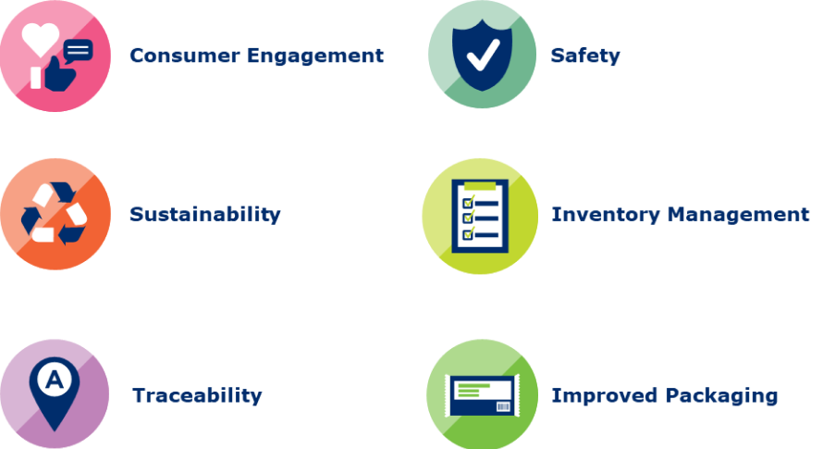
The six key drivers explained
Back to step
Consumer Engagement
Use of 2D barcode solutions encoded with the GTIN + web-enabled links gives brand owners the opportunity to provide consumers with richer product data and shopper engagement.
Inventory Management
Although current barcodes can be used for inventory accuracy, it is limited. 2D barcodes encoded with the GTIN + more granular data can offer first in/first out manageability, reduce waste and increase efficiency in the supply chain.
Improved Packaging
Clean, purposeful packaging can be achieved through improvements such as reducing the number of barcodes on-pack or simplifying scanning options.
Sustainability
2D barcode solutions create opportunities to help the economy, society and environment, such as sharing recycling information, lifecycle visibility and revalorisation.
Safety
2D barcodes encoded with date(s) can be used to identify products nearing expiration resulting in reduced product waste and product safety for consumers.
Traceability
Sharing richer product data such as product identification and place of purchase across the retail value chain can help create opportunities for improved consumer protection.

Slide 92
Sector-specific examples
Back to step
Step
Sector
Example
Brand owner pathway
Sub step 5.4
Apparel
Consider making the 2D Barcode as small as possible. Use the module count tool to help you.
Brand owner pathway
Sub step 5.6
Apparel
Visit this resource for symbol placement examples for clothing and fashion accessories.
Retailer pathway
Sub step 1.1
Use of 2D barcodes to in store labelled products (e.g. deli meats, cheeses, pre-cut fruits and vegetables) can enable automatic expiry date tracking, facilitating targeted discounts for products approaching best-before, while maintaining clear product visibility for your customers.
Fresh foods
Retailer Pathway
Sub step 1.2
Refer to Woolworths’ case study for an example of scoping a pilot and scaling up for in store labelling to improve inventory management, expiry date management and allow consumer engagement through sharing traceability information.
Fresh foods

Slide 93
Glossary
Back to step
Term
Definition
GTIN
Global Trade Item Number. It is the GS1 identification key used to identify trade items. The key comprises a GS1 Company Prefix, an item reference and check digit.
CPV
Consumer Product Variant. It is an alphanumeric attribute of a GTIN assigned to a retail consumer trade item variants for its lifetime.
Dynamic data
Dynamic data is information that can change or be updated in real-time or based on specific conditions, such as serial number. Key drivers traceability, sustainability, safety and inventory management require encoding of dynamic data and require additional considerations.
Static data
Information that remains constant, for example the GTIN is product information that is unchanging and remains the same in the barcode data. In case consumer engagement/improved packaging are the only key drivers, there are less considerations since only static data needs to be encoded.
HRI
Human Readable Interpretation: Represents the same data encoded in the barcode e.g. GTIN
Non-HRI
Non-Human Readable Interpretation: All other text on the product packaging on the product packaging which may or may not be encoded in the barcode

