Slide 1
Preparing a attribute work request template –
Attribute Definition for Business template -
Quick Guide
Steve Robba, Director of Standards Development, GS1 Global Office
Updated July 2021

Slide 2
Preliminary
This guide is only to help prepare the Attribute template.
  Quick download of template can be found:
  https://www.gs1.org/sites/default/files/docs/gsmp/attribute_gmd_template.xlsx
  The full guide with more examples and details can be found:
  https://www.gs1.org/sites/default/files/docs/gsmp/how_to_fill_out_attributes_templates.docx
To learn how to fill out a GS1 work request, please refer to “Work Request Form Guidance” https://www.gs1.org/sites/default/files/docs/gsmp/work_request_blank_question_template.docx
All entries in the document shall be made in English UK. There are instances for formal names (Company names, Brands, etc.), when the original language may be used.

Slide 3
Prerequisite
If you are requesting a New (Add) attribute, an Attribute Definition for Business template must be attached as part of the work request as an additional document.
  Click here: https://www.gs1.org/sites/default/files/docs/gsmp/ADB_template.xlsx
If you are requesting to Delete an attribute:
  1) You must put in a Change also to the definition stating: NOTE: This attribute will be deleted in a future release. Use attribute … and/or Code…. instead.
  2) You must also include a migration template and must be attached as part of the work request as an additional document.
    Click Here: https://www.gs1.org/sites/default/files/docs/gsmp/migration_gmd_template_feb_21.xlsx

Slide 4
Attribute template

Slide 5
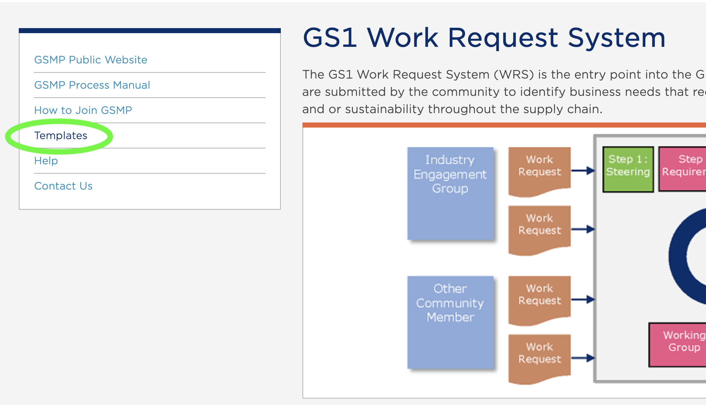
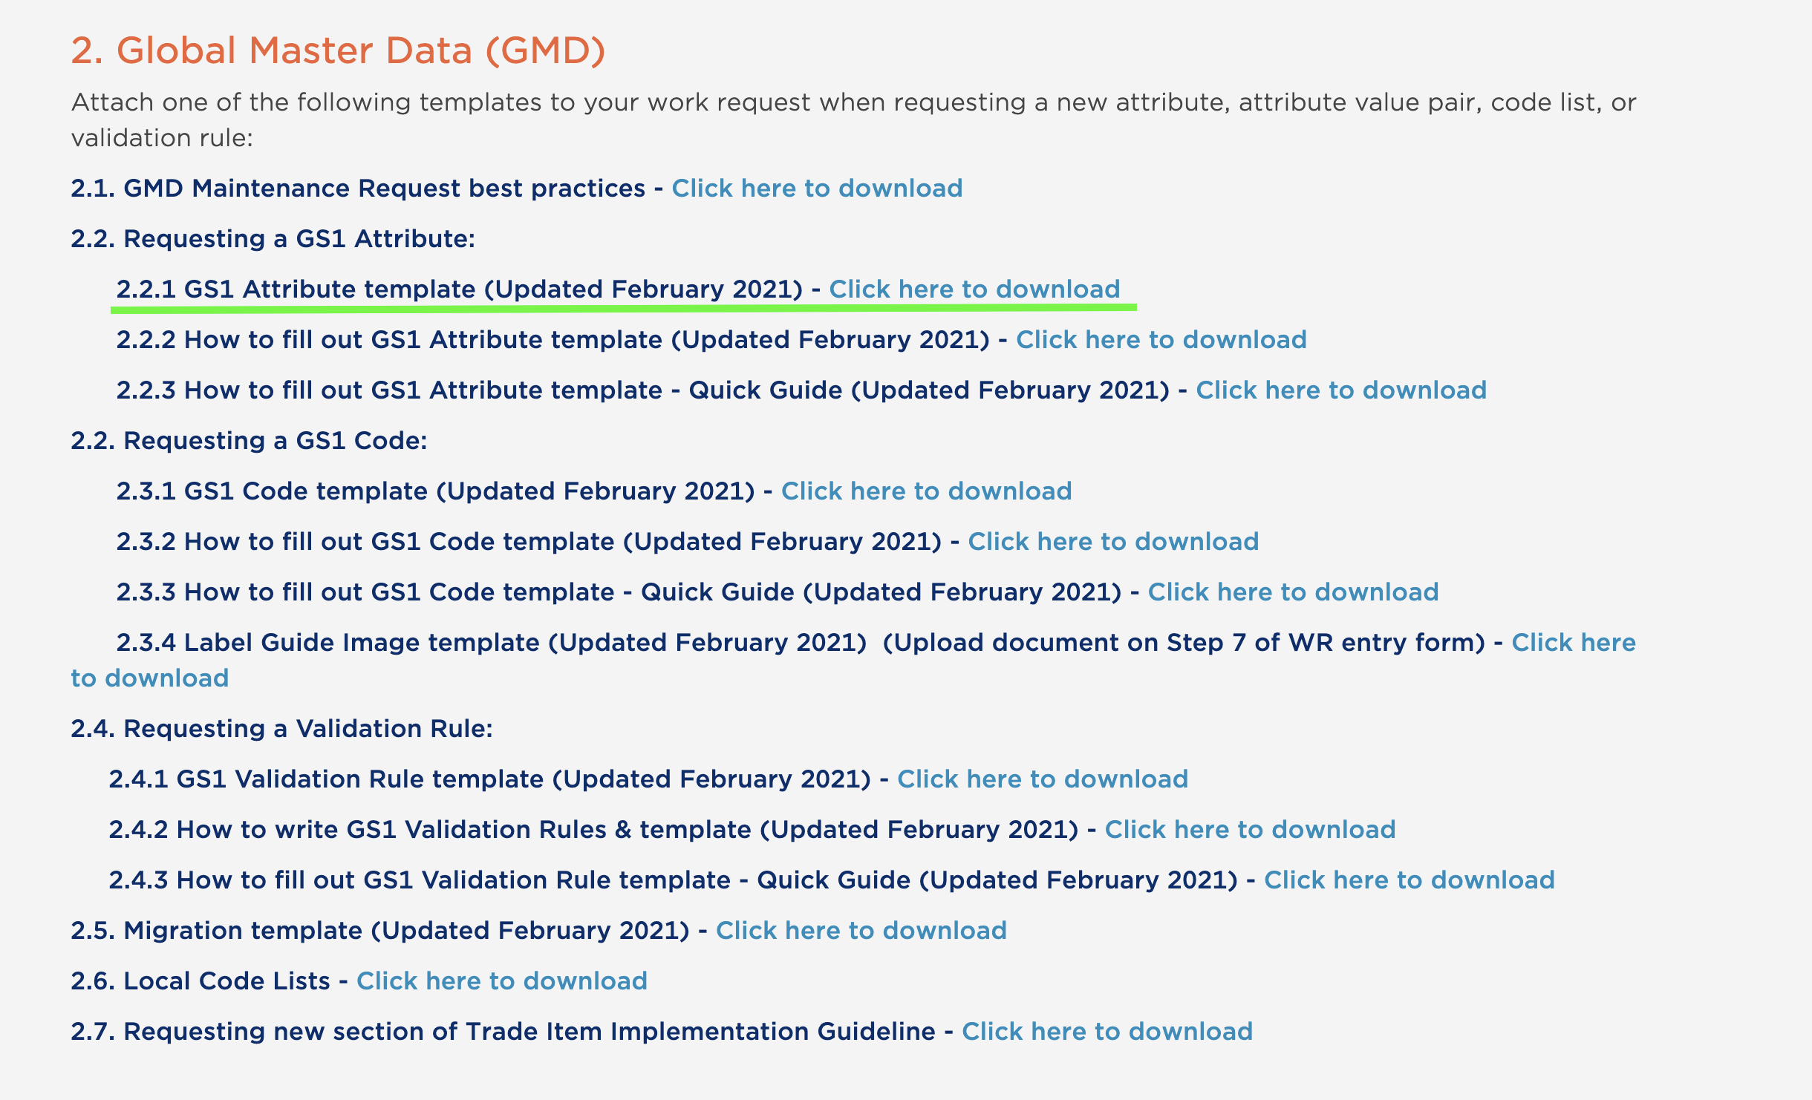
Download the Attribute template from website
Go to http://wr.gs1.org
Select “Templates”
Requesting a GS1 attribute
Click or Right click link for 2.2.1

Slide 6
Attribute Template
Always begin entering at line 5
Never delete rows 1 through 4.
Row 1 the work request system uses to populate the proper fields in the system.
Row 2 & 3 are provided as examples.
Row 4 is the line for brief instructions and to notify user to start at row 5.

Slide 7
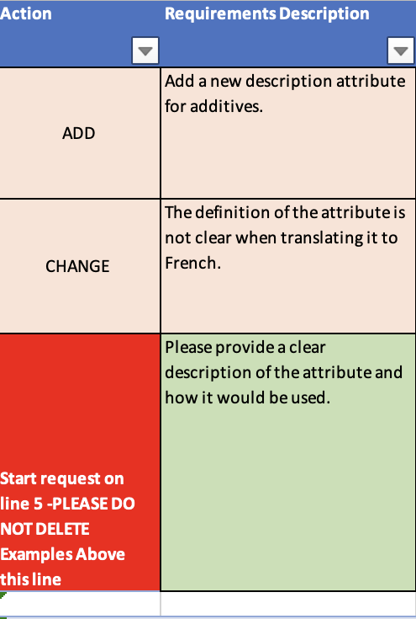
Attribute Template
Action general template instructions
  ADD - Fill out all columns to the best of ability.
    An Attribute Definitions for Business template must be submitted for all ADDs.
  CHANGE – Fill out attribute name and
  what changes you require only. All columns do not need to be filled out. Do not use colour fonts or strikethroughs to demonstrate changes.
  DELETE – A delete must come with a Change for the definition stating the attribute is being deprecated and instruction on what to use.
    A migration template must be submitted for all deletions.

Slide 8
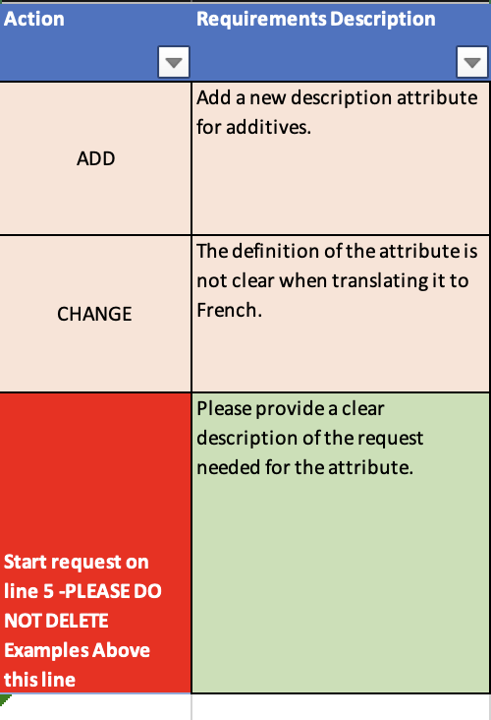
Attribute Template
Action & Requirements Description
Action: Simply select from the drop down:
  ADD for a new attribute, class or module
  CHANGE for a change to an existing attribute
  DELETE to remove an existing attribute
Requirements Description:
  Please provide a clear description of the request needed for the attribute. This is not the business rationale.

Slide 9
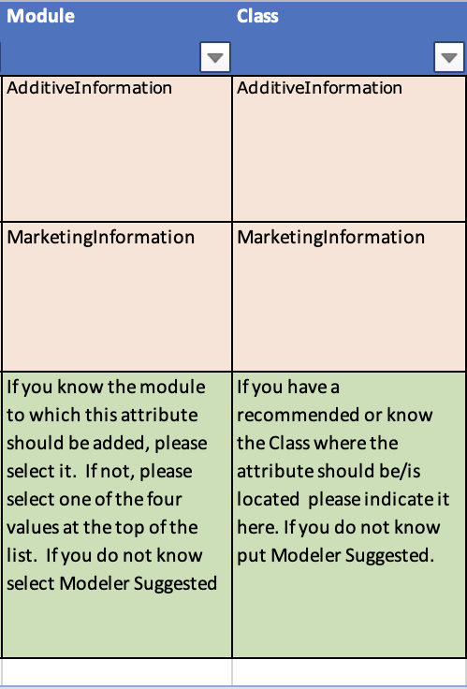
Attribute Template
Module & Class
Module - from the drop-down list a selection SHALL be provided.
  A Module is a group of attributes that make up a logical set of information.
  If you do not know the name of the module, select “- Modeler Suggested –“.
Class - the class field is optional. If you know where you would like an attribute to be placed within a module, specify which class.
  The format for a class is always Upper case for each word in the class.

Slide 10
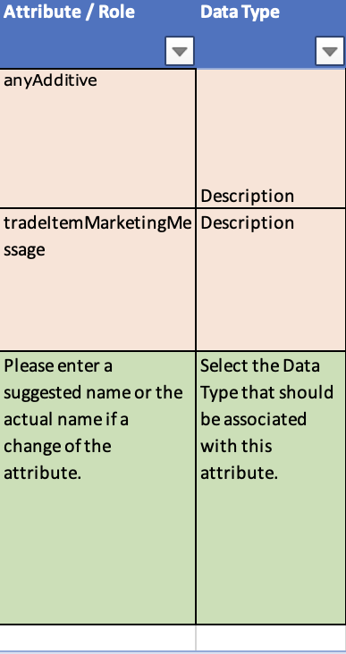
Attribute Template
Attribute/Role & Data Type
Attribute/Role: The attribute being requested, changed or deleted SHALL be provided, except if this is a request for a new class.
  All attributes SHALL begin with a lower case first letter and each word following will be upper case proper.
Data Type: from the drop-down list a selection SHALL be provided with an add or if the data type is changing.
  Do not use: Description/Free Text, Description1000, Description200, Float-UOM, MeasurementUnitCode, NonBinaryLogicEnumeration-ISO3166_2, Numeric

Slide 11
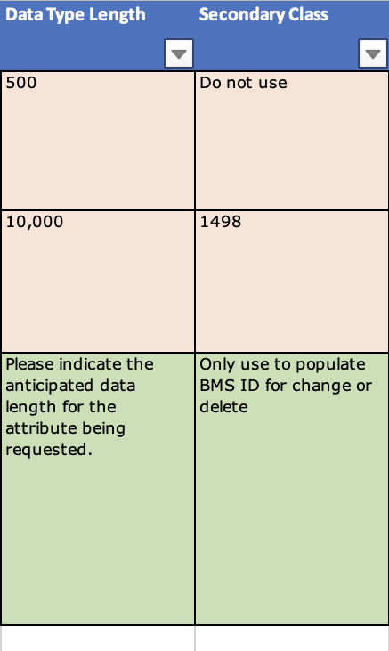
Attribute Template
Data Type Length & Secondary Class
Data Type Length - To describe the length of the field needed.
  Only use this for the following data types as all other are pre-defined data types.
    Description – this is for multiple language enabled
    Formatted Description – if there is a need for a language enablement for a sequence to order the descriptions.
    String – free text field with no language enablement
Secondary Class - On changes and deletes of attributes, use this as a temporary field for BMS ID

Slide 12
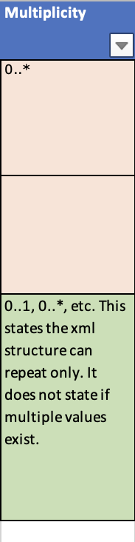
Attribute Template
Multiplicity
From the drop-down list a selection SHALL be provided with an add or if the data type is changing. A data type is how the XML is structured.
  0..1 Optional attribute, only 1 value allowed
  1..1 Mandatory attribute, only 1 value allowed
  0..* Optional attribute, repeating values
  0..* Optional attribute, repeat different language, measurement, currency, ONLY 1 value per type - Validation needed to stop multiple of the same type
  0..* Optional attribute, repeating language, measurement, currency, multiple value per type
  1..* Mandatory attribute, same as above

Slide 13
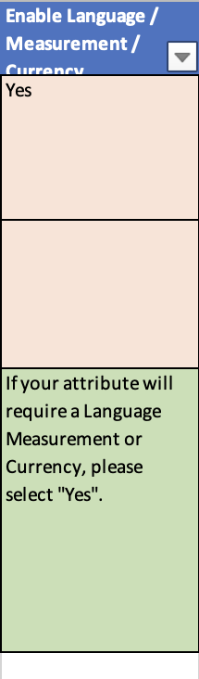
Attribute Template
Enable Language / Measurement / Currency
From the drop-down list a selection SHALL be provided with an add or if the data type is changing.
Select Yes for the data type below:
  Amount – this is currency enabled
  Description – this is for multiple language enabled
  Formatted Description – if there is a need for a language enablement for a sequence to order the descriptions.
  Measurement – a decimal with a unit of measure
  Time Measurement – seconds, minutes, hours, days….
Else select No for all other data types.

Slide 14
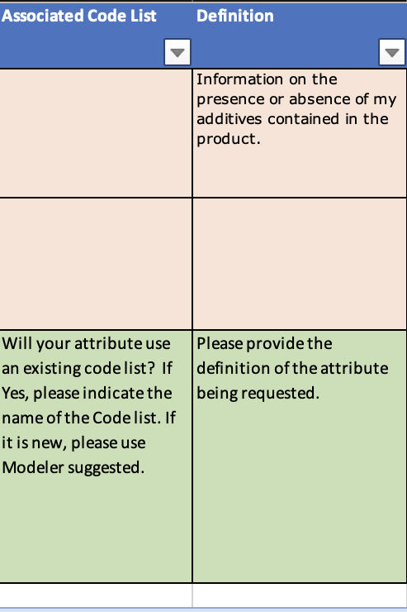
Attribute Template
Associated Code List & Attribute Definition
Associated Code List - If the attribute is a codelist populate the codelist that the attribute is using for valid value. This used for new codelist attributes. There should be a code work request submitted with this.
Attribute Definition - All new attribute requests SHALL have a business friendly and succinct definition. A change to a definition SHALL NOT use font colours nor strikethroughs to represent changes.
  All definitions SHALL have proper punctuation.
  All acronyms SHALL be in parenthesis after the full text of the acronym has been stated.
  A definition SHOULD be able to give a visual representation of the attribute being requested.
  Definitions SHALL NOT just repeat the attribute name. Be descriptive and explain what you are requesting the user to populate.
  A definition SHALL be able to be understood globally. Avoid using colloquial or local sayings.

Slide 15
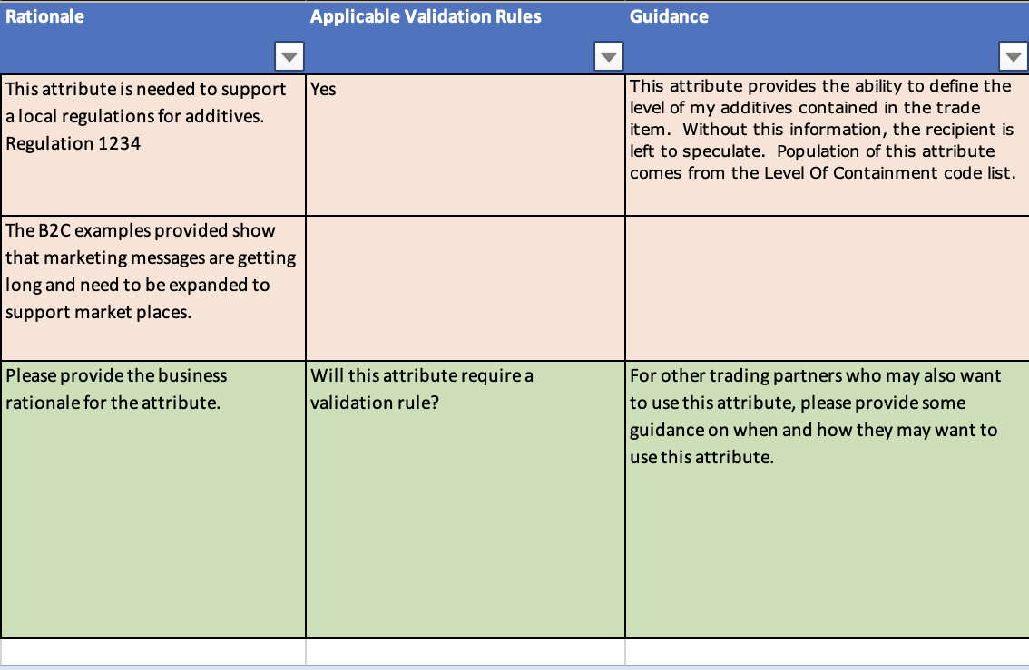
Attribute Template
Rationale & Applicable Validation Rule & Guidance
Rationale – Please provide the business rationale for the attribute. This is SHALL NOT be that the community wants this.
  Answer the questions:
  “Why does the community want this?”
  “What business benefits can be achieved?”
  “What purpose or how does the recipient use this information?”
Applicable Validation Rule - If you are submitting an additional business validation work request, please state the validation rule here.
Guidance - Provide any business process notes that would help the users to supply/make use of this information provided in this attribute.

Slide 16
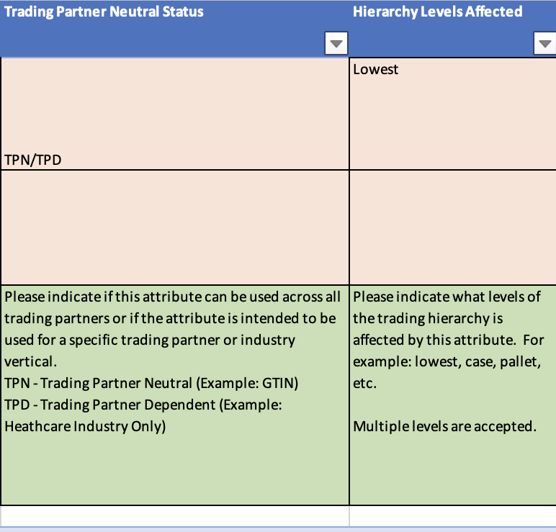
Attribute Template
Trading Partner Neutral Status & Hierarchy Levels Affected
Trading Partner Neutral Status – From the drop-down, select if the data for the recipients can vary by values for trading partners within a market or they must remain the same.
  TPN – Values remain neutral/the same for all trading partners.
  TPD – Values can change for trading partners (ex. Price attributes)
  TPN/TPD – Values can be neutral but there are instances when they need to vary by partner.
Hierarchy Levels Affected - State which level of the trade item hierarchy a value should be populated on as data is not always applicable to all levels. Examples: Pallet, Case, Base Unit, Consumer Unit, and All.

Slide 17
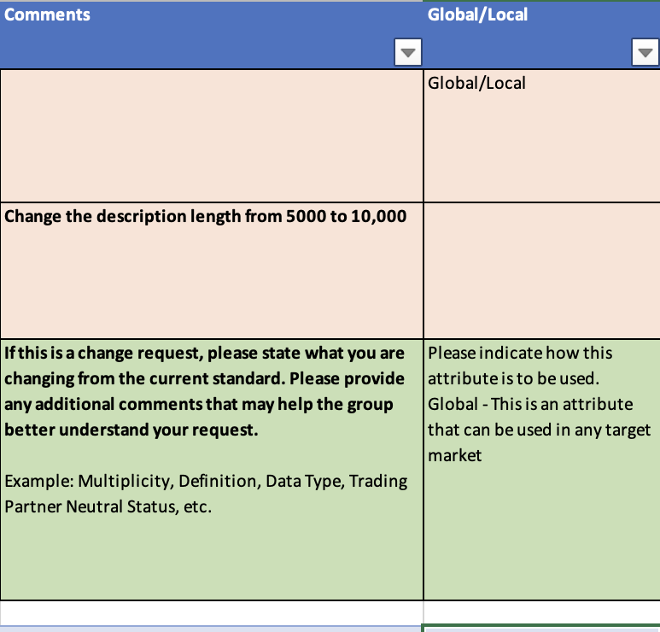
Attribute Template
Comments & Global/Local
Comments– For CHANGE include the text being remove or changed.
Global/Local – select from the drop-down.
  Global means for this GTIN across all markets the attribute must have the same value. Example Computer memory cannot vary by market.
  Global/Local means the values can vary by market but can be the same too. Example descriptions. (Majority of items)
  Local means that the value varies by every market (Very rare)

Slide 18
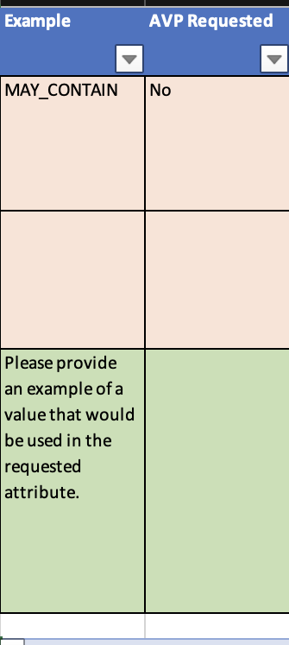
Attribute Template
Example & AVP Requested
Example – This SHALL contain an example of data to be populated.
AVP Requested – temporary attribute requested (Check with GS1)
  Note: The community who implements this temporary attribute will need to migrate to the standard attribute once adopted in the standard release.

Slide 19
Attribute Definition for Business template

Slide 20
Change to a new attribute in Global Master Data
New! GMD attributes will be created with an Attribute Definitions for Business
  GS1 Attribute Definitions for Business (ADB) provide business-friendly names, definitions, examples and usage statements that simplify meaning and usage of standard attributes for business users and communities.
How? Add a WR as you do today with the attribute Excel Template and attach the ADB Excel
  Attribute Excel upload document - The GMD GS1 Attribute Template already includes a “Definition” column, which will now be used to enter the Business Definition (i.e., going forward, all attribute definitions will be Business Definitions)
  ADB Excel attachment document for the following fields -
    Business Attribute Name (which differs from the “Attribute/Role”, i.e., technical attribute name, specified in the GS1 Attribute Template)
    Technical XML Tag
    Business Example
    Business Usage Statement

Slide 21
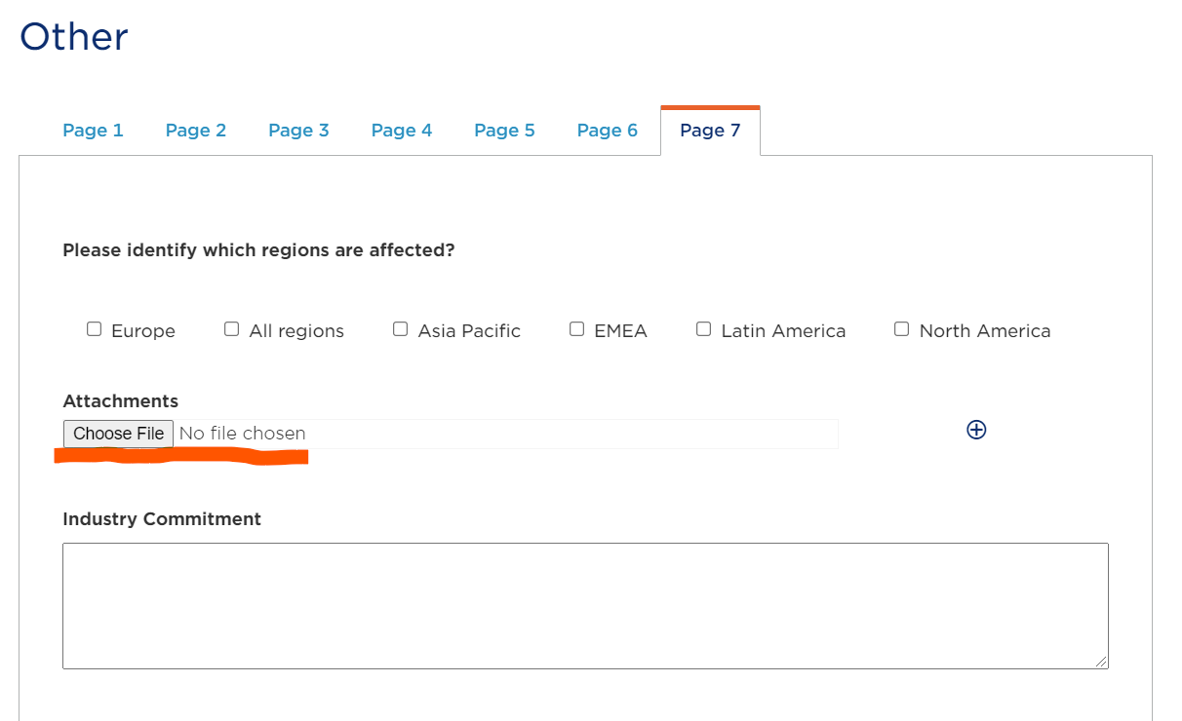
ADB Template Location
The Attribute Definitions for Business template is located
  Click here: https://www.gs1.org/sites/default/files/docs/gsmp/ADB_template.xlsx
This gets uploaded during the work request entry on Page 7 at wr.gs1.org

Slide 22
Guidance for Creating Attribute Definitions for Business

Slide 23
Attribute Definitions for Business
Basics
What are Attribute Definitions for Business?
  Names, definitions, examples and usage statements associated with GDD standard attributes that describe the information that must be supplied and how they might be used by every-day business personnel.
    Definition is technology agnostic.
    Attribute names and definitions using words and phrases recognized in a business context.
    Real world examples of how an attribute would be populated in business terms.
    Business Usage statements that convey how the attribute information is used by business throughout the product life cycle.
      From manufacturers through to consumers.
  ADBs are used in conjunction with GDSN and the Global Data Model

Slide 24
Attribute Definitions for Business
Practical Approach
Put yourself in the place of a business person:
  Does the name convey an obvious meaning to users across the world?
  Does the ADB information contain useful keywords?
    Example: users searching for attributes relating to a specific business function or product category
  Is the definition specific enough to clarify meaning and avoid confusion with other similar attributes?
  Do the examples provide common use cases that apply to the attribute?
    Example: across different geographic regions, product categories and business processes
  Does the usage statement describe who would use this information, and why they should use it?
  Does the usage statement reference other related attributes that are commonly used in conjunction?
  Is all ADB information created using words and sentence structures that are easy to understand by users for whom English may not be their primary language?

Slide 25
Attribute Definitions for Business
Development Guidance
Business Attribute Name: clearly and concisely conveys the attribute content using business (not technical) terms
  Significant words are capitalized and separated by blank spaces, for example: “Count of Each Specific Product”
  Acronyms (when needed) SHALL be fully expanded, for example: “Contact Information GLN (Global Location Number)”
  Business Name SHALL include “Code”, “Type Code” or “Indicator” for those types of attributes
  Refrain from using the word “Product” as the lead word of the Business Name
    Exception: where it’s required to form an integral understanding of what the attribute is by name
    Exception: where it’s required to differentiate the attribute from another attribute of a similar name
Business Definition: describes the meaning of the attribute’s data content in terms of the product or business process to which it applies
  Start all Business Definitions with “The”, for example: “The code”, “The amount” or “The measurement”
  Use common business terms that will be recognized by most users involved with trading the applicable product or implementing the related business process
  Be aware of, and include where possible, alternate terms used in different geographies or trade channels

Slide 26
Attribute Definitions for Business
Development Guidance
Business Example: provides explicit examples of how to populate the attribute’s data for one or more common use cases
  Provide multiple examples when needed to help users understand the different ways the attribute could be populated based on product type, geography, business process, etc.
  Use the same specific examples for attributes that are related and are commonly used together
  For codes, include a representative sample of code names and explain their meanings if not obvious
  Provide (where possible) the actual attribute value that would be populated
Business Usage Statement: conveys the way the information is used in real life by people involved in the product supply chain, from manufacture through consumer purchase
  Begin usage statements with “Used to” or “Used by”
  When groups of attributes are commonly used together, list these using the statement “Used in conjunction with…”
  Referencing GS1 standards is permissible, but avoid specifying links that may change based on date or release number; do not reference external documents or web sites

Slide 27
Guiding principles for ADB
Do not use abbreviations for units of measure (e.g., “gram” – not “gr”, “grm” or “GRM”)
“Product” or “service” (not “physical” or “non-physical”)
Never “recipient” or “retailer” … always “buyer”
Never “supplier” … always “seller”
Consistent use of terms as defined in the ADB Glossary
The word “Shall” will be used rather than “Must”
Always reference the ADB Business Name, not the GDD Name, unless no ADB Business Name exists. For example: change ”… isTradeItemAConsumerUnit …” to “… Consumer Unit Indicator ...”
Present all attribute names (ADB or GDD) in italics
Add the URL when it is to a GS1 website (avoid URLs to external sources)
Remove references to local rules and regulations
Show multiple examples for the same attribute using a bulleted list (i.e., not numbers, dashes or something else)
Indications of Yes/No responses (such as those for Boolean logic) are expressed as True/False
Refer to the GS1 Style Guide [https://www.gs1.org/docs/GS1_Style_Guide.pdf] for guidelines related to non-branded images, grammar, capitalization and other styling topics.

Slide 28
ADB Glossary
item – a generic term often used to refer to the physical object of a logistic packaging hierarchy for the product (e.g., trade item)
product – usually referring to the consumer unit
unit – a generic term often used to refer to the item in a business activity, sometimes prefixed with the business purpose (e.g. consumer unit, logistic unit, selling unit)
buyer – entity that purchases an item (e.g. retailer, hospital, distributor, etc.)
seller – entity that sells an item (e.g. manufacture, distributor, GPO, etc.)
each – often used to refer to the consumer unit (i.e. the item that the consumer purchases)
pack – a unit hierarchically between the each and the case. This may be a consumer unit (e.g. carton of cigarettes) and/or a logistic unit (e.g. box of cans)
case – a logistic unit (e.g. a box) that usually contains a product or packs
pallet – a logistic unit that is usually a collection of cases on a wooden platform
Additional terms can be found in the GS1 Glossary

Slide 29
Examples

Slide 30
Attribute Definitions for Business
ADB examples – process-oriented attribute
Technical XML Tag | Business name | Definition | Example | Usage Statement
dataRecipient | Authorised Receiver of Product Information GLN (Global Location Number) | The Global Location Number (GLN) that uniquely identifies the authorised receiver of the product information. | • Private label information directed to one specific buyer. • Promotional information for a specific retailer. • Product information shared with a solution provider for dissemination to multiple recipients. | Used by the buyer to identify themselves within the GDSN network. Used by the supplier to specifically provide a buyer with product data.

Slide 31
Attribute Definitions for Business
ADB examples – logistics related attribute
Technical XML Tag | Business name | Business definition | Example | Usage Statement
quantityOfTradeItemsPerPallet | Count of This Specific Item in a Non-GTIN Logistic Unit | The count of this specific item in the non-GTIN logistic unit. | • pallet with 50 cases with the attribute called out equal to 50 • pallet with 20 cases of one product and 30 cases of a different product, with the attribute called out for each equal to 20 and 30, respectively • irregular pallet without a GTIN, indicating the total number of items | Used by the seller to communicate to the buyer the number of items in a logistic unit, such as a pallet. The buyer uses this information for automation of the picking and stacking process in the warehouse.

Slide 32
Attribute Definitions for Business
ADB examples – trade-oriented attributes
Technical XML Tag | Business name | Business definition | Example | Usage Statement
countryOfOriginStatement | Country of Origin Declaration | The statement about the country of origin, as declared on the product label, which can be any country where the product is indicated to have come from (it may or may not be the same as Country of Origin Code). | • Made in Vietnam • Made in the EU | Used to inform the consumer of the specific country of origin as declared on the product.
countryCode | Country of Origin Code | The code used to declare where the product is produced for regulatory / custom's requirements. In the case of multiple countries, the country in which the last substantial process or operation, that is economically justified, was performed. | • Cheese produced in France with Swiss milk from Swiss cows - code for France. • A pack of cereal with grains from multiple countries, processed and packed in Spain - code for Spain. • Tea bags produced in the Netherlands from tea grown in Ceylon - code for the Netherlands. • A product is produced in one country OR another. • Additional repacking or stickering does not constitute COO - Made in the US sent to Mexico for repackaging - code for US. | Used to meet regulatory / custom's requirements for specifying the country of origin.

Slide 33
Attribute Definitions for Business
ADB examples – related attributes that reference each other
Technical XML Tag | Business name | Business definition | Example | Usage Statement
additionalTradeItemClassificationSystemCode | Additional Product Classification Type Code | The code indicating the type of Additional Product Classification Value used. | Image of: • box of cereal and its United Nations Standard Products and Services Code (UNSPSC) and value. • the same box of cereal with its eCl@ss code and value. • box of syringes with its Global Medical Device Nomenclature (GMDN) Code and value. | Used to declare the type of the additional product classification that allows a buyer to know which classification system is used. Used in conjunction with Additional Product Classification Value.
additionalTradeItemClassificationCodeValue | Additional Product Classification Value | A value, other than the Global Product Category Code, which classifies the product, based on the Additional Product Classification Type Code. | Image of: • box of cereal and its United Nations Standard Products and Services Code (UNSPSC) and value. • the same box of cereal with its eCl@ss code and value. • box of syringes with its Global Medical Device Nomenclature (GMDN) Code and value. | Used for additional product classification that allows a buyer to classify a product by other classification systems. Used for multiple use cases such as data quality, category management, space management, workflow routing. Used in conjunction with Additional Product Classification Type Code.

Slide 34
Attribute Definitions for Business
ADB examples – related code and descriptive attributes
Technical XML Tag | Business name | Business definition | Example | Usage Statement
precautionaryStatementsCode | Precautionary Statement Code | The code (also known as a P code) identifying the standard phrase describing precautionary actions or correct handling. | • P102: Keep out of reach of children • P211: Do not spray on an open flame or other ignition source • P221: Take any precaution to provide mixing with combustibles…. | Used to identify the standard phrase(s) describing precautionary actions when storing or handing the product.
precautionaryStatementsDescription | Precautionary Statement Description | The description of the specified precautionary statement (also known as P statement) on a hazardous label. | • P102: Keep out of reach of children • P211: Do not spray on an open flame or other ignition source • P221: Take any precaution to provide mixing with combustibles… in a temperature of 7 degrees Celsius. (The additional information is inserted into the standard precautionary statement in the specified position.) | Used to communicate to the buyer and consumer the nature of a precautionary measure to be taken when storing or handling the product. May be provided on the packaging.

Slide 35
Attribute Definitions for Business
ADB examples – product-oriented attributes
Technical XML Tag | Business name | Business definition | Example | Usage Statement
functionalName | Product Type Description | The generic description provided by the seller to describe the type, form or function of the product or service. | • liquid laundry • powder laundry • laundry pod • detergent • toothpaste • facial tissue • potato chips vs. potato crisps | Used by the buyer to help classify the product or service. Can also be used for discovery.
regulatedProductName | Regulated Product Name | The product name provided by the seller in adherence with laws, regulations or administrative provisions applicable in the country. Not all products have a regulated name. | • Bakery product of rye flour • Natural yogurt | Used to identify to the consumer the prescribed, regulated or generic name of a product. This differentiates the regulated name from any other name the product may be known by for marketing purposes.

Slide 36
Attribute Definitions for Business
ADB examples – descriptive business examples
Technical XML Tag | Business name | Business definition | Example | Usage Statement
minimumTradeItemLifespanFromTimeOfArrival | Minimum Days of Shelf Life at Arrival | The seller's determination of the minimum number of calendar days of shelf life of the product, based upon the expiration date on the product, upon receipt by the buyer. | Seller X has shipped a case of pasta and has a minimum number of days of life from arrival of 400 days and buyer validates at time of receipt that product has 400 or more days of life remaining. Product with an expiration date with the minimum number of days of shelf life at arrival = 14. | Used by the buyer for quality and inventory control workflows/business processes.
minimumTradeItemLifespanFromTimeOfProduction | Minimum Days of Shelf Life from Production | The seller's determination of the minimum number of calendar days from the production date to the expiration date. | The seller guarantees 1/2 of the shelf life which equals 60 days at the time of arrival to the buyer. The buyer compares the production date on the packaging to the current date at time of arrival to ensure that at least 60 days remain. | Used by the buyer for quality and inventory control workflows/business processes.

Slide 37
Any questions please contact GSMP@gs1.org

